Slide 1

Introduction to the National Dental Practice-Based Research Network
[INSERT YOUR NAME AND OTHER INFORMATION HERE]
Support: U.S. NIH grants U19-DE-28717 and U01-DE-28727

Slide 2

Moving things forward with PBRNs
If we want more evidence-based practice, we need more practice-based evidence.
Lawrence W. Green, DrPH

Slide 3
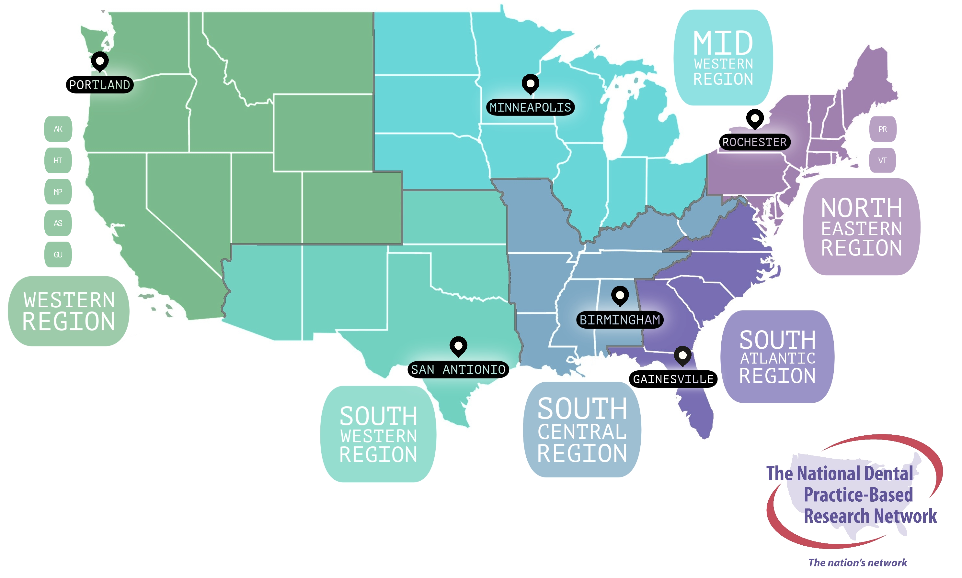
The National Dental PBRN Regions

Slide 4



more than 8,500 dental practitioner members across the USA
connected through six universities or research institutes, one in each region plus a specialty node
59 studies led by network investigators since 2005

Slide 5
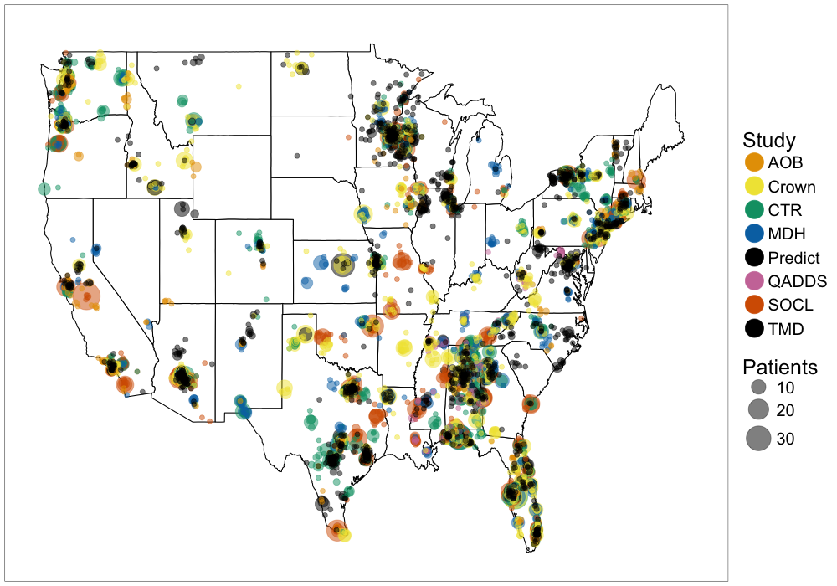
Distribution of 15,462 patients enrolled in 8 second-cycle Network studies
*Plus 10 in Alaska (CTR)
*Plus 15 in Puerto Rico (AOB)

Slide 6





Benefits as reported by network dentists
Increases stature of my practice
Conveys to patients that I “stay current”
New rewarding collegial interactions
Compensated for time spent doing research
Participate as much or as little as I like

Slide 7
As reported by network dentists in survey

Slide 8
As reported by network dentists in survey

Slide 9

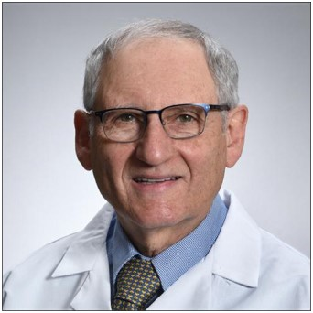
“My participation with the PBRN over the years has been one of the highlights of my career. The opportunity to take part in well designed clinical studies has improved the quality of care I was able to provide and elevated my office in many ways. From enhancing the way both patients and team members felt about the office to improving our procedures on a daily basis, being a valued member of the PBRN has been a privilege.”
Laurence H. Stone, DDS., MAGD
Doylestown Dental Solutions PC
Doylestown, PA

Slide 10


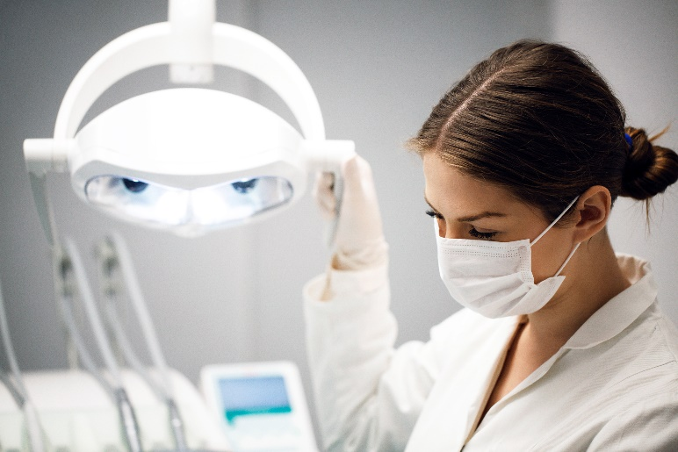

We are with you every step of the way!
registration
investigation
publication

Slide 11

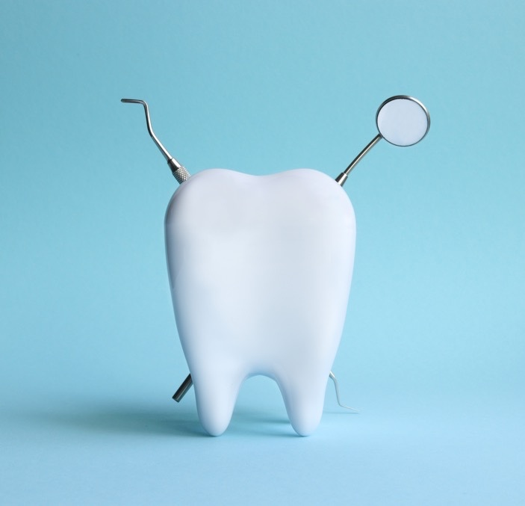

So, why should YOU
join the network?
It’s free
Receive research information that is free from bias and based on evidence
Participate in studies relevant to you and your patients
Free continuing education (CE) credits
Collegial interactions with fellow network members
Practitioners and patients’ compensation for study participation
Notes:
So, why should YOU join the network?
It is both a benefit and a privilege for the dental profession to have had a funded network for these many years.
Since is funded by NIH, and paid with your tax money, it is a benefit to you that you could use.
The major benefit is to have access to RESEARCH INFORMATION that is FREE FROM BIAS from industry and BASED ON EVIDENCE
Another benefit is the chance to participate in studies that you choose, that are relevant to you and to your practice and patients
You also have the opportunity to interact with academicians, researchers and fellow network members from across the entire United States.

Slide 12
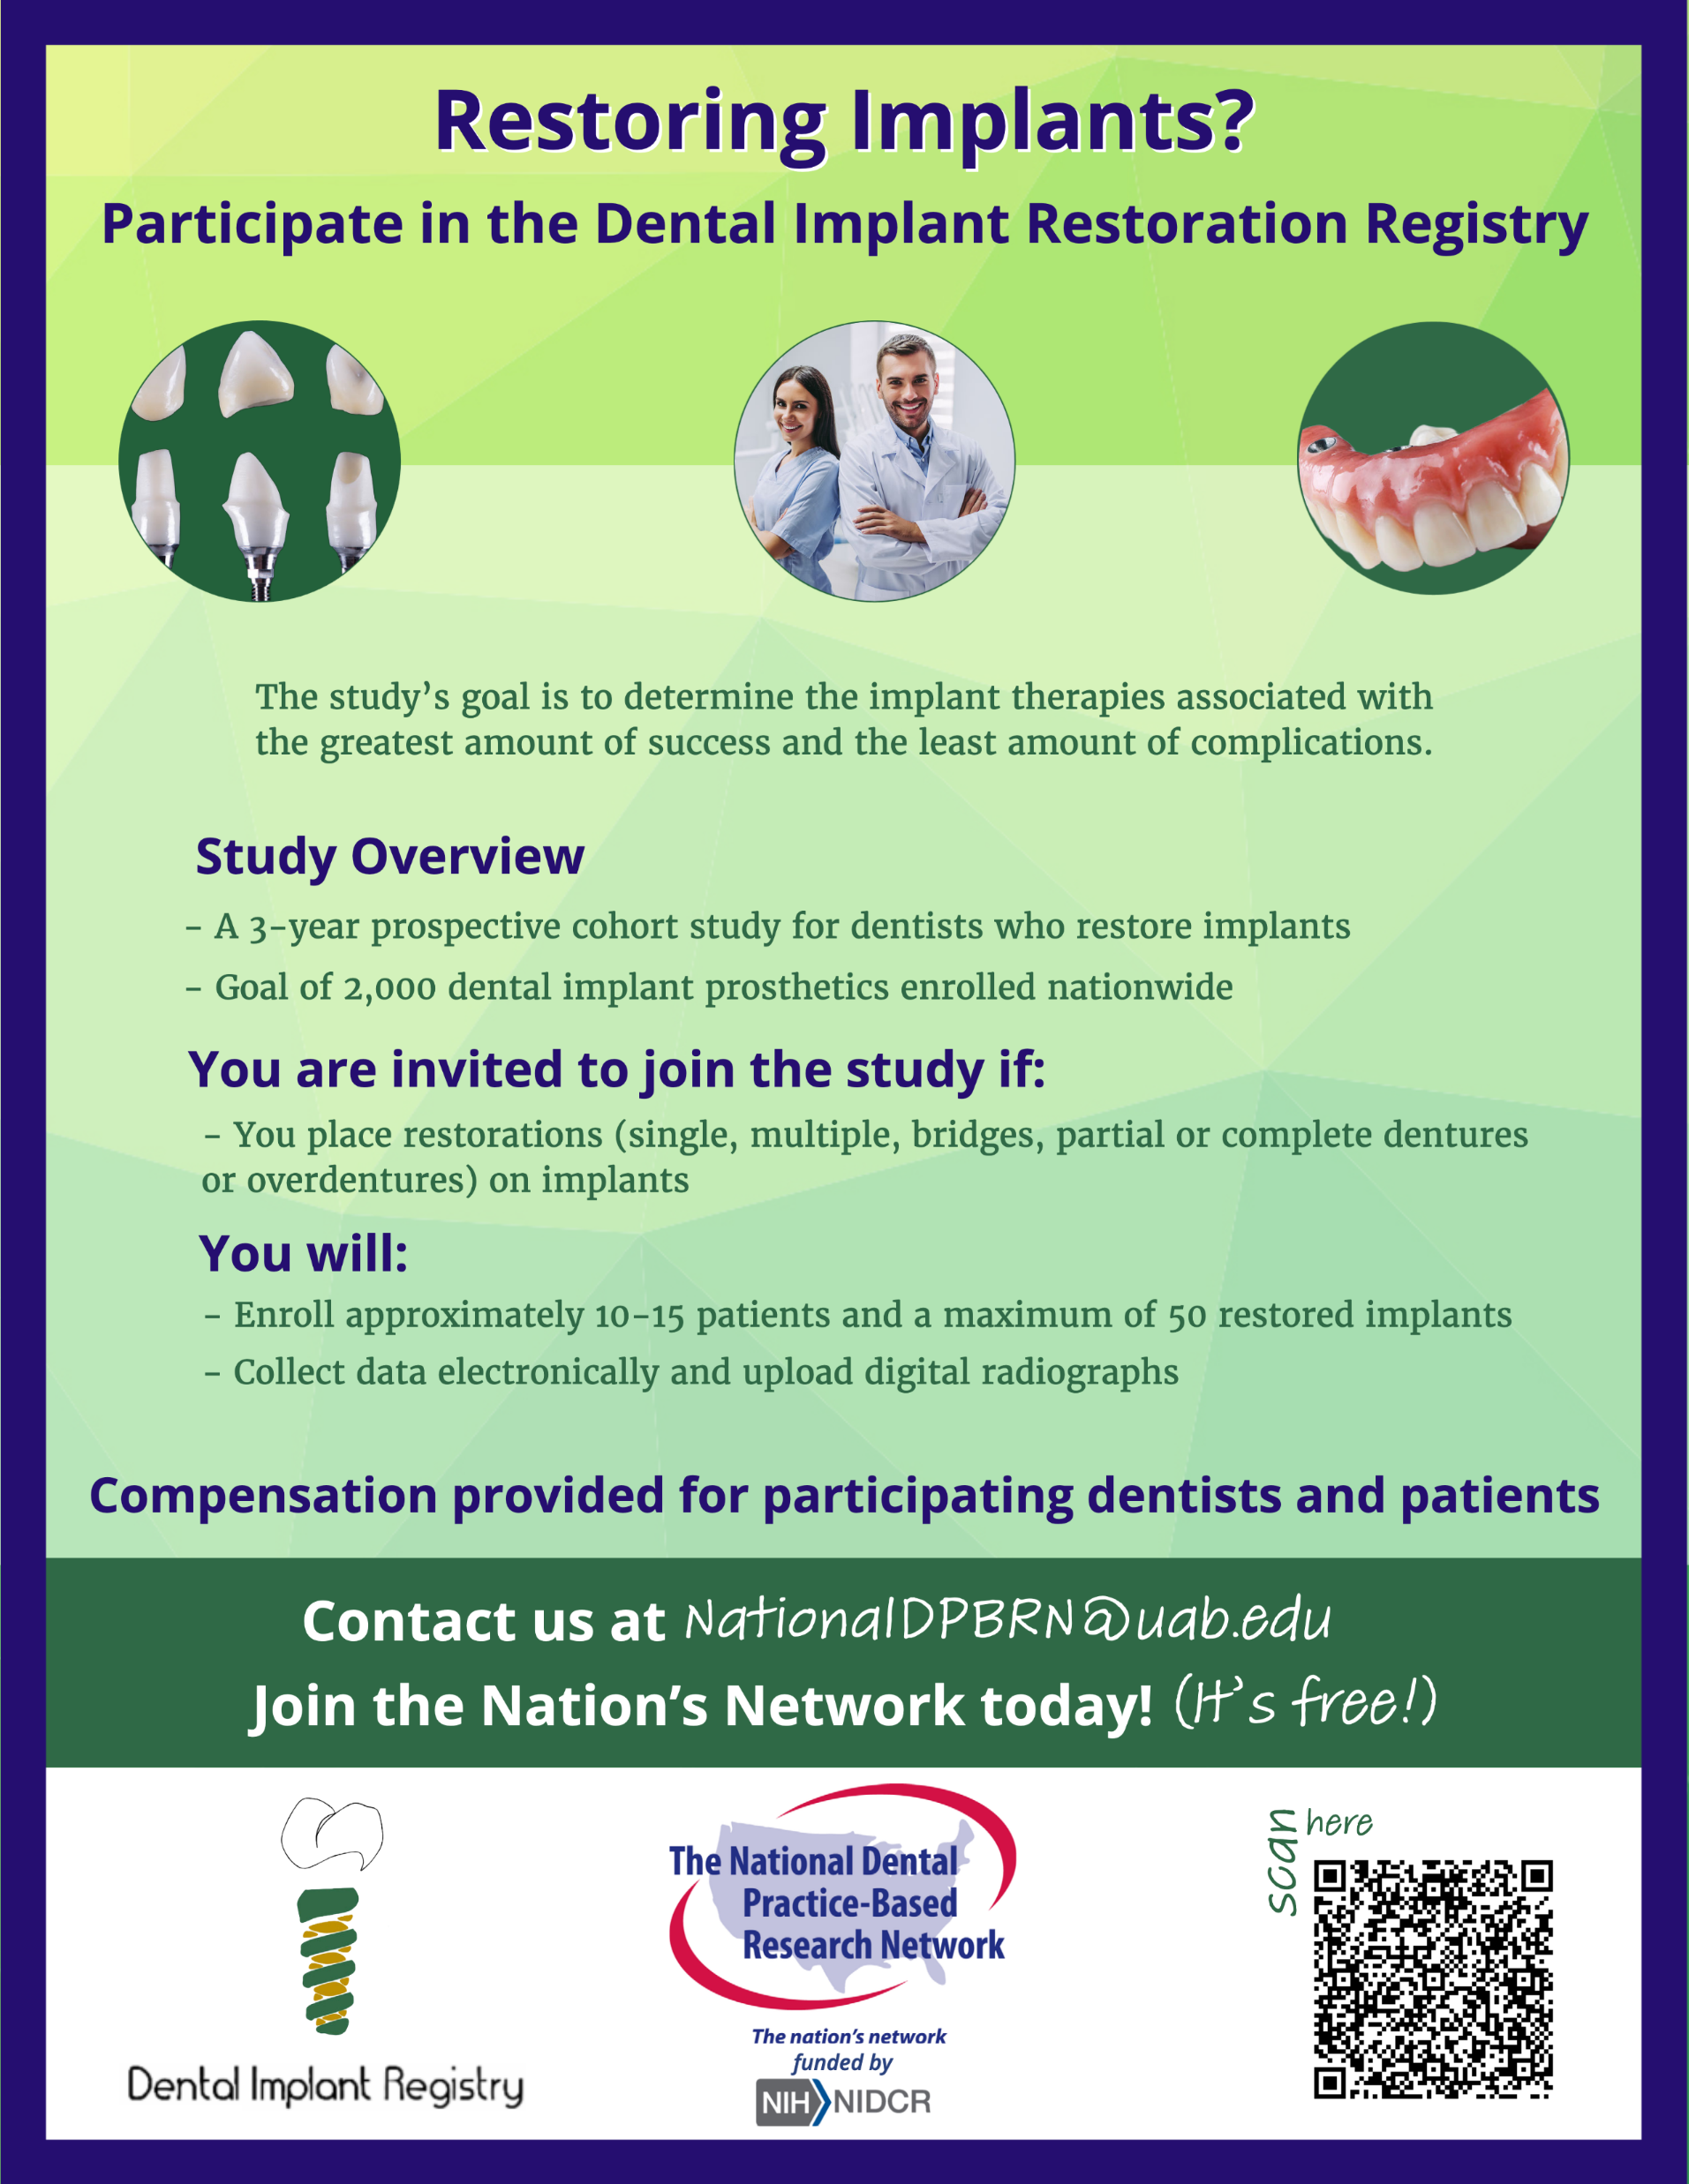

Details at:
https://www.nationaldentalpbrn.org/blog/the-implant-registry-study-is-recruiting-dentists-who-restore-implants/
Find out more:

Slide 13
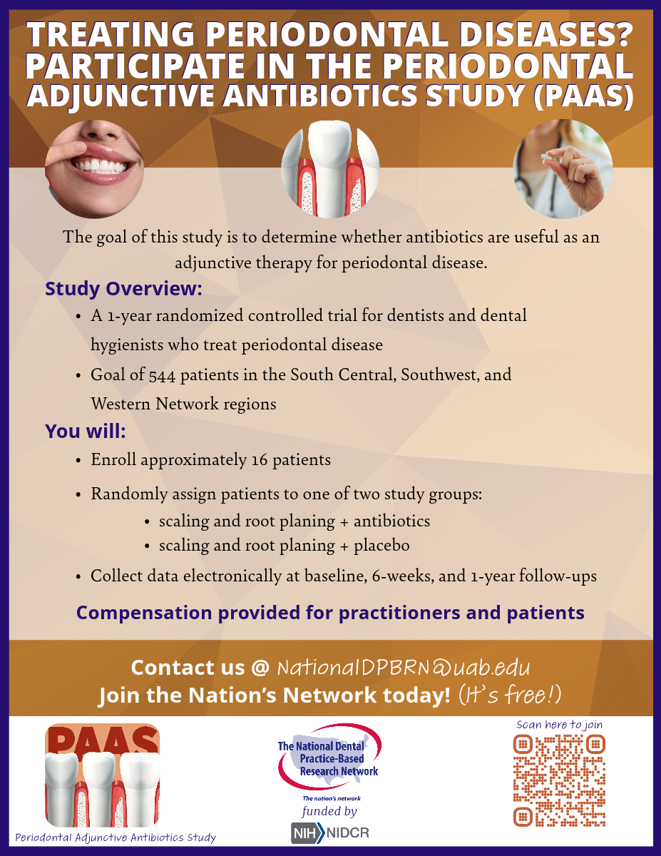

Details at:
https://www.nationaldentalpbrn.org/blog/paas/
Find out more:

Slide 14

Participation in the periodontal adjunctive antibiotics study (PAAS)
WHICH PATIENTS CAN PARTICIPATE?
  Are 40 years old or older.
  Are being treated for periodontal disease stage II-III, grades A-C (previously generalized moderate- to-severe periodontitis).
  Have not used systemic antibiotics in the previous 3 months.
  Have not had periodontal therapy (including SPR D4341, D4342) in the previous 6 months.
WHY SHOULD YOU PARTICIPATE?
  Advance the science and practice of periodontology
  Participating dentists or hygienists will receive a total of $250 remuneration per participant:
    $100 baseline, $100 re-evaluation and $50 at the final visit
    $4,000 upon enrolling the target sample size of N=16 participants
    $5,500 if enroll the maximum of 22 participants
  Patients will be compensated $50 per study visit

Slide 15
Join the Network!

Slide 16
Please contact us if you have any further questions, we are happy to assist you!
Aleena Potluri
(205)975-3113
apotluri@uab.edu

