Slide 1
Recruitment and Retention in Dental Practice-Based Research Networks
Strategies for Success in Dental Studies
Presented by: David Cochran, DDS, PhD and Rahma Mungia, BDS, MSC, DDPHRCS,
U.S. National Institutes of Health grants
U19-DE-28717, U01-DE-28727; U19-DE-225616; U01-DE-16746, U01-DE-16747

Slide 2

Introduction to recruitment & retention in dental PBRNs
Objective: Overview of key challenges in recruiting and retaining dental patients in research.
Content: Highlight the unique environment of dental PBRNs and the importance of successful recruitment and retention for impactful oral health research.
Notes:
Welcome, everyone, to our session on recruitment and retention in dental PBRNs.
Today, we'll provide an overview of the key challenges in recruiting and retaining dental patients for research while highlighting the unique environment of dental Practice-Based Research Networks.
By understanding these challenges, we can appreciate how successful recruitment and retention are critical for conducting impactful oral health research that ultimately improves patient care and advances our field.
The National Dental PBRN has been funded since 2005, completing three funding cycles with 55 studies completed and 3 currently ongoing.

Slide 3
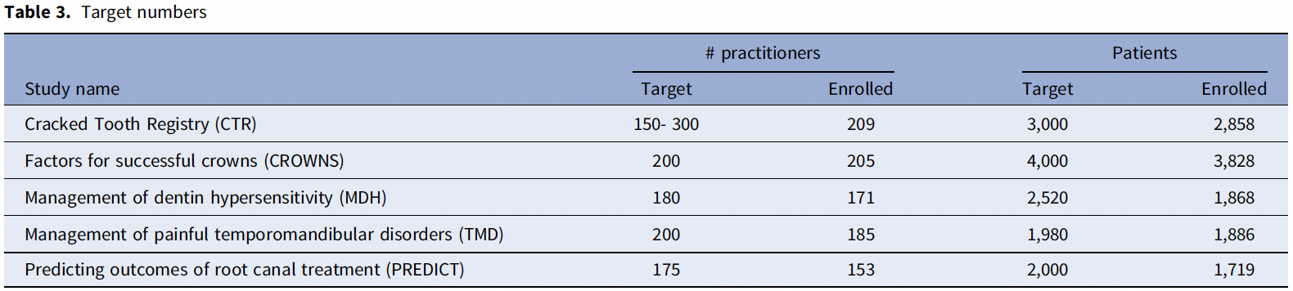
Recruitment success from National Dental PBRN Studies
Visual Recruitment Tools
Compelling Incentives
Targeted Patient Identification
Personalized Patient Engagement
Unified Team Approach
Effective Follow-Up Strategies
Mungia et al., 2024
Notes:
I'm excited to share some key strategies that have driven our recruitment success in the National Dental PBRN. This overview is based on an analysis of five clinical studies conducted during the 2012–2020 funding cycle.
Let’s begin by reviewing this table, which outlines our core recruitment metrics and provides an overview of the five studies and their acronyms that we’ll reference throughout the presentation.
As we move forward, I’ll break down the main strategies we’ve implemented—each one has played a critical role in engaging patients and supporting study enrollment. These include: Visual Recruitment Tools, Compelling Incentives, Targeted Patient Identification, Personalized Patient Engagement, A Unified Team Approach, and Effective Follow-Up Strategies.
I’ll cover each of these in more detail over the next few slides, highlighting how they’ve been applied and the outcomes we've seen as a result.

Slide 4

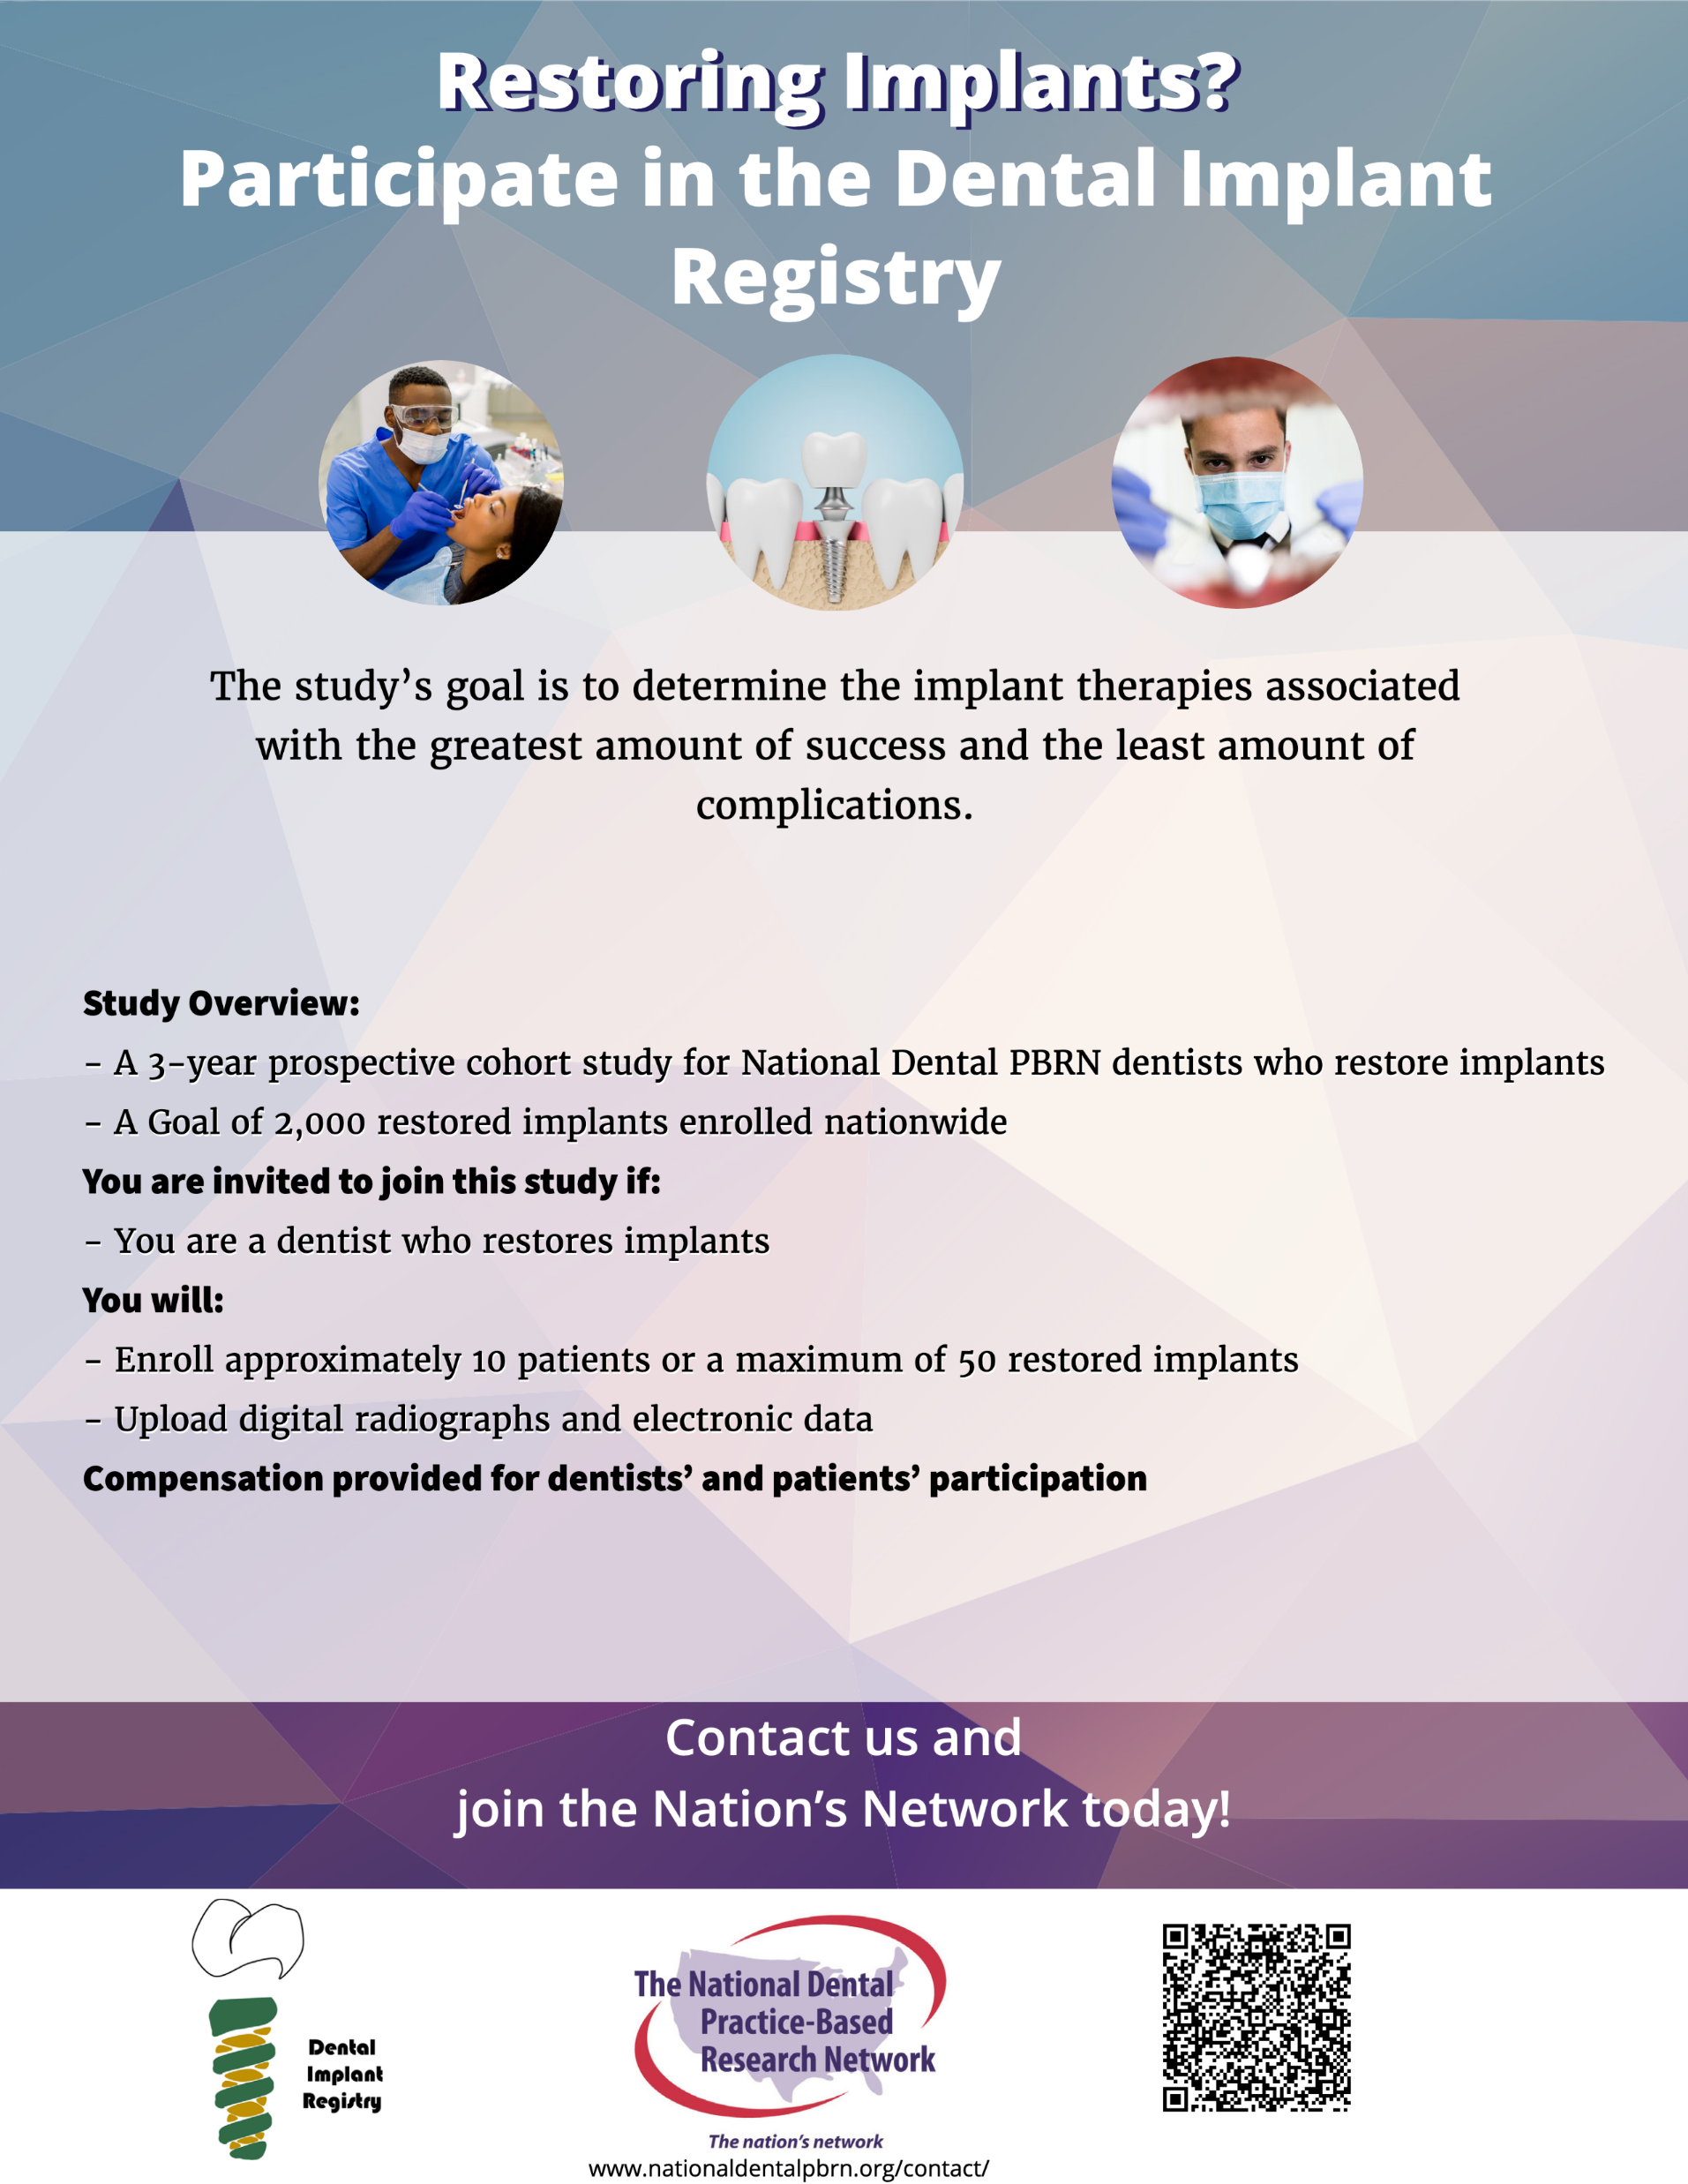
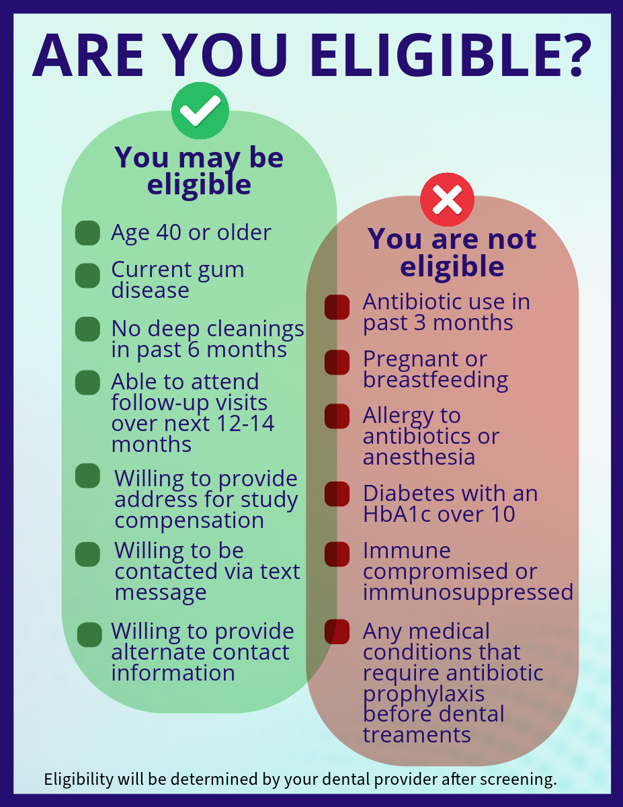
Patient flyers
Example: Practitioner Recruitment success from National Dental PBRN studies
Notes:
First, let’s talk about Visual Recruitment Tools.
We strategically place flyers in dental offices that not only raise awareness but also provide clear, detailed information about our studies. These engaging materials give patients a tangible source of information during their visits, making it easier for them to understand what the study entails.
To further enhance our recruitment efforts, we introduce compelling Incentives. By offering attractive remuneration options, we provide tangible acknowledgments for participation. We make sure to clearly communicate these incentives, which significantly enhances the appeal of our studies.

Slide 5
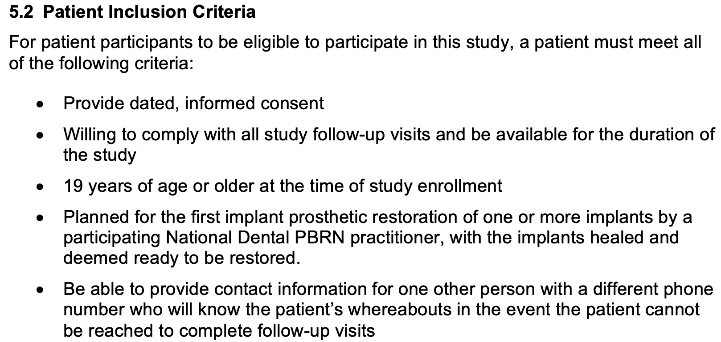
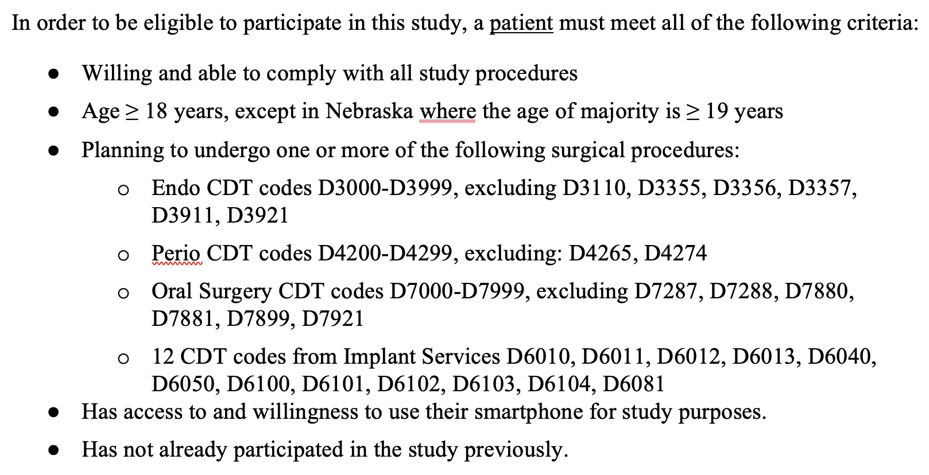
Example: Targeted Patient Identification
Dental Implant Restoration Registry Study
  Conduct systematic chart reviews on appointment days to pinpoint eligible participants.
  Real-time assessments of procedure code streamline recruitment by focusing on those most likely to qualify.
Post-Operative Dental Pain Study
Notes:
Let’s now shift our focus to Targeted Patient Identification—a key strategy for streamlining recruitment.
Study coordinators train practitioners and office staff to review daily appointment schedules during morning huddles to identify potentially eligible patients in advance. On appointment days, trained team members—such as front office staff, hygienists, or assistants—conduct real-time chart reviews to flag patients meeting study criteria. This proactive approach ensures recruitment is timely, efficient, and focused.
For example, in the Dental Implant Restoration Registry (DIRR) study, practitioners flagged patients scheduled for their first implant prosthetic restoration, provided their implants had properly healed. Similarly, in the Post-Operative Pain Study (POPS), patients were pre-identified based on upcoming procedures with relevant billing codes.
This method enhances recruitment efficiency and improves accuracy by identifying qualified participants right at the point of care.

Slide 6
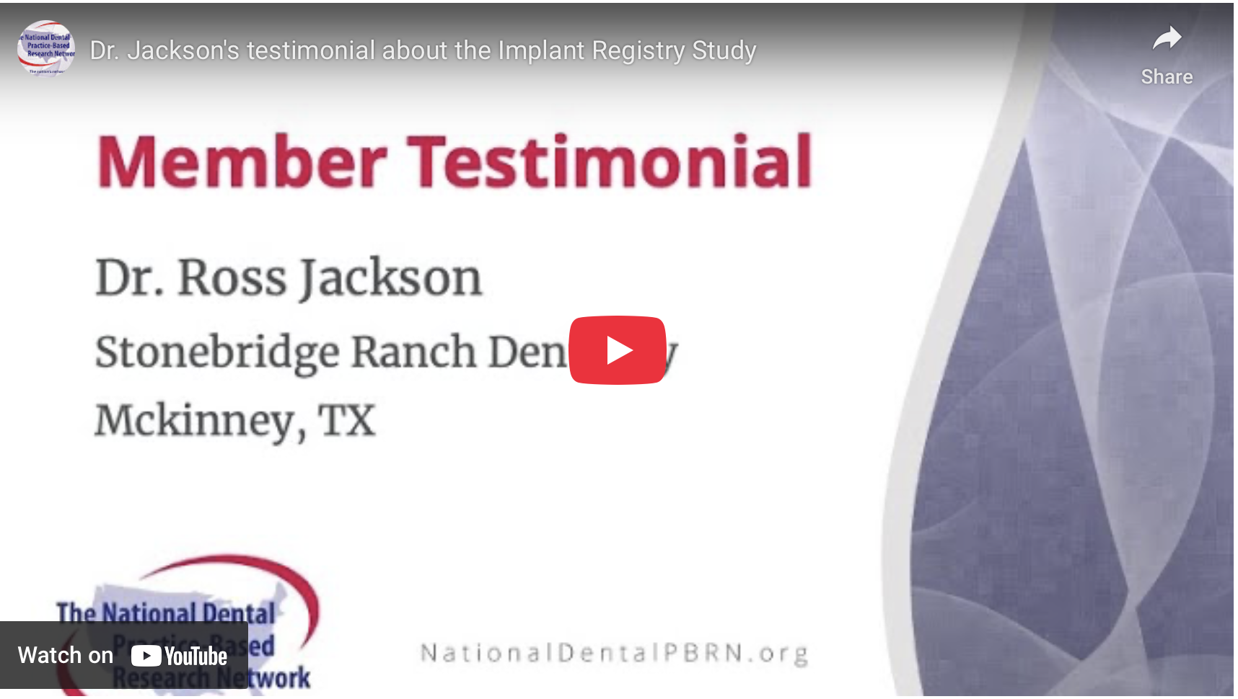

Example: Unified Team Approach
  Engage and train dental office staff to promote study details consistently and accurately.
  Establish a collaborative environment that supports patient recruitment and retention.
Notes:
Our Unified Team Approach ensures every member of the dental practice is aligned and supported throughout the recruitment process.
We deliver structured training sessions—lasting about 45 minutes to an hour—to both practitioners and staff. These sessions are led by our study coordinators (SCs) and include detailed visual presentations, step-by-step implementation guides, and quick-reference materials that clarify study goals, recruitment protocols, and team roles.
These trainings require significant preparation, with SCs dedicating time to customize the session for each practice setting. They work closely with teams to troubleshoot clinic-specific challenges and ensure that the recruitment workflow fits seamlessly into daily operations. This hands-on, collaborative model boosts confidence, encourages team ownership, and sets the tone for successful patient engagement and retention.
To illustrate the impact of this training, we’ll now play a short testimonial from one of our practitioners who completed their training and successfully enrolled their first patient.

Slide 7
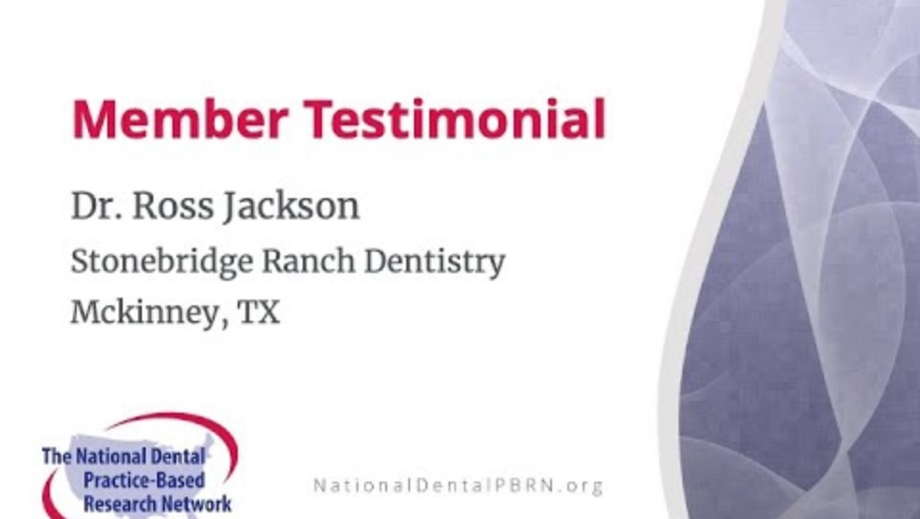

Example: Personalized Patient Engagement
  Leverage strong patient-dentist relationships during routine appointments to discuss study benefits.
  Foster trust and understanding, actively motivating patient participation.
Notes:
One of the most effective tools we have for driving study enrollment is the strong, trusted relationship between patients and their dental providers. During routine appointments, we encourage practitioners to personally introduce the study and explain its benefits. This direct and familiar approach builds trust and significantly increases a patient’s willingness to participate.
But it doesn’t stop there, our study coordinators also play a crucial role. They work hand-in-hand with practitioners to provide the most current, relevant study information and supporting materials. This ensures that what practitioners share with their patients is accurate, consistent, and tailored to address common questions or concerns.
We equip clinicians with success stories, clear talking points, and practical communication tips to help guide their conversations with patients. This support from our coordinators not only builds trust but also improves the overall patient experience. We continuously refine these tools by sharing best practices learned across our studies.
In the end, it’s this dual investment, nurturing both the patient-dentist connection and the coordinator-practitioner partnership, that makes our recruitment efforts so effective. This model has proven essential to boosting participation and ensuring the success of our National Dental PBRN clinical studies.

Slide 8

Example: Effective Follow-Up Strategies
Confirm patient contact details (home phone, cell phone, email)
Ask for a secondary contact, such as family members
Establish tracking procedures in the protocol
Regular reminder calls and emails
Notes:
Lastly, we use effective follow-up strategies to keep patients engaged and reduce attrition. At the time of enrollment, we confirm and record accurate contact details—like phone numbers and emails—for both patients and practitioners. This allows us to send systematic reminders through calls, texts, and emails leading up to each follow-up visit.
These reminders aren’t just for patients—we also keep practitioners informed and involved with timely updates to help maintain momentum and coordination at the practice level.
By combining these follow-up methods with the strategies shared earlier—such as visual tools, targeted patient identification, personalized communication, compelling incentives, and a unified team approach—we’ve seen consistent success in recruiting and retaining participants in National Dental PBRN studies.
Together, these efforts not only strengthen participation but also play a vital role in advancing meaningful, practice-based dental research.

Slide 9
Retention success from National Dental PBRN studies
Effective Retention Strategies
  Personalized Communication
  Financial Incentives (follow-up visits)
  Updated Contact Databases
Study Design and Scheduling
  Short Recruitment Periods
  Strategically Timed Visits
Digital Engagement
  Remote Meetings & Online Assessments
  Higher Retention Among Specific Demographics
Investment in Recruitment
Mungia et al., 2024
Notes:
Now, let’s discuss our effective retention strategies pretty similar to recruitment that have been instrumental in keeping both patients and practitioners engaged in our studies.
First, we emphasize Personalized Communication. Our team maintains continuous and positive interactions with all participants (patients and practitioners/staff), fostering both informal and professional relationships. This approach builds trust and keeps everyone informed and engaged throughout the study.
We offer Financial Incentives. By providing tangible rewards for participation, we encourage ongoing involvement and show our appreciation for the commitment of our participants.
We also ensure effective communication through Updated Contact Databases. By regularly maintaining and updating participant information, we can reach out promptly and keep our lines of communication open.
Our study design further contributes to retention. We limit patient recruitment to 6–12 months to prevent practitioner fatigue and maintain enthusiasm. Short recruitment periods help manage workload and keep participation manageable. In addition, we schedule visits strategically. By aligning recall periods with patient routines and insurance cycles, we maximize follow-up adherence and make it easier for patients to keep their appointments.
Digital Engagement is a critical component of our recruitment and retention strategy. By conducting remote meetings with practitioners and enabling patients to complete assessments online through platforms like survey platform (REDCap), we significantly reduce the need for ongoing in-person contact. This approach not only streamlines communication but also makes participation more convenient for both practitioners and patients.
We’ve also found that certain demographic groups—particularly women, older adults, and those with higher education levels—are more likely to participate in digital assessments. These insights allow us to customize our engagement strategies to better reach and support specific patient populations.
Finally, one of the most impactful strategies is our investment in recruiting practitioners into the network. We’ve seen that practitioners who enroll a higher number of patients tend to demonstrate greater commitment to the study. Their ability to clearly communicate the value and purpose of the research not only boosts patient retention but also cultivates a more engaged and motivated study environment.
When we combine this practitioner-driven momentum with our broader recruitment and retention strategies, we establish a strong foundation that supports sustained participation and contributes meaningfully to the overall success of our studies.

Slide 10
Example: A long-term follow-up success from multi-year dental studies
High Overall Patient Follow-Up in 5 Studies:
97% Retention: Out of 12,159 patients, 11,736 participated in at least one follow-up activity (online or clinic-based).
Digital (Online) Follow-Up Success:
In studies requesting online assessments (MDH, TMD, PREDICT):
  95% of patients (5,191 out of 5,473) completed at least one online follow-up.
  83% of patients (4,537 out of 5,473) completed all requested online assessments.
Clinic-Based Follow-Up Success:
In studies requiring clinic visits (CTR, CROWNS):
  98% of patients (6,545 out of 6,686) completed at least one clinic visit.
  In the CTR study, 71% of patients (2,033 out of 2,858) completed all three recall visits.
Mungia et al., 2024
Notes:
This slide highlights one of the most critical components of successful clinical research, patient retention. In one of our long-term dental studies, we kept nearly all of our participants engaged over time, with an impressive retention rate of 97%.
For studies that used digital follow-ups, like management of dentine hypersensitivity (MDH), management of painful temporomandibular disorders (TMD), and predicting outcomes of root canal treatment (PREDICT), nearly all patients completed at least one online assessment, and a large majority completed every requested assessment.
Similarly, for studies that required in-person visits, like the cracked tooth registry (CTR) and factors for successful crowns (CROWNS), almost all patients showed up for at least one follow-up appointment, and many completed all three.
These outcomes reflect the strength of our follow-up strategies and show how our efforts to build relationships and keep participants engaged really do pay off over the course of a study.

Slide 11
Maintaining long-term follow-up in oral health studies
Schedule follow-up visits to coincide with routine dental care to reduce patient burden.
Send regular reminders via phone calls, texts, or emails.
Foster relationships with patients through personal check-ins.
Provide incentives for continued participation (e.g., dental hygiene kits, gift cards).
Notes:
Overall, we retain patients by making participation convenient, aligning follow-ups with routine care, and staying in regular contact through reminders. Personal check-ins help build trust, while small incentives like hygiene kits or gift cards keep patients engaged and appreciated throughout the study.

Slide 12
Practitioner Engagement Strategies form the National Dental PBRN
Inclusive Research Process
Practical Study Design and Workflow Integration
Continuing Education (CE) Incentives
Regular Meetings and Networking Opportunities
Digital Engagement and Communication
Supportive Research Environment
Mungia et al., 2020
Notes:
Now, let’s shift our focus to practitioner engagement strategies. Successful patient recruitment relies heavily on practitioner engagement and retention. Practitioners' continued involvement is key to meeting enrollment goals and ensuring consistent study operations.
As highlighted on this slide, the National Dental PBRN has developed robust strategies to foster long-term practitioner commitment and support a collaborative research culture.
We involve practitioners in every step of the process, from study design, protocol development, and data interpretation. To support implementation, we align study protocols with routine dental workflows and offer streamlined training through brief orientation videos, reference tools, and training sessions. Participation is further incentivized through free continuing education credits for human subjects training, study-specific modules, and network meetings and symposia attendance.
Engagement is sustained through ongoing opportunities, such as co-authorship on study manuscripts, regional practitioner meetings, and digital touchpoints like webinars, videos and brief surveys through our newsletter, also called quick polls.
Lastly, we offer free Network membership to build a supportive, community-driven environment that promotes both practitioner retention and broader patient participation.

Slide 13
Practitioner CE Credit Analysis from National Dental PBRN
Overall CE Credit Earned:
59% (n = 2,586) of practitioners earned CE credit from the Network.
Breakdown of CE Sources:
68% (n = 1,757) earned CE credit from a video.
38% (n = 993) attended an annual Network meeting.
31% (n = 798) received CE credit for training for a Network clinical study.
9% (n = 226) attended a national symposium.
7% (n = 170) participated in a Network webinar.
Practice Setting Influence:
  Members of 2 large group practices earned, on average, more CE credits than practitioners from other practice settings.
Co-authorship in Publications/Presentations:
  4% (n = 159) of practitioners coauthored a Network presentation or publication.
Mungia et al., 2020
Notes:
Here are some key highlights of our practitioners’ engagement with CE opportunities through the Network:
As shown on the slide, nearly 60% of practitioners earned CE credit—most commonly by watching educational videos, with others participating through clinical study trainings, annual meetings, national symposia, or webinars.
On the right side of the slide, you’ll see Network findings that show practitioners in large group practices tend to earn more CE credits than those in other settings. Additionally, 4% of practitioners have co-authored a Network presentation or publication. These contributors are more likely to be general dentists, members of large group practices, or graduates from before the year 2000.
Together, these patterns show how ongoing CE opportunities and scholarly involvement strengthen both professional development and long-term engagement in the Network.

Slide 14
Practitioner Retention success from National Dental PBRN Clinical Studies
Overall Practitioner Engagement and Retention example in 5 studies:
591 Practitioners enrolled patients across five clinical studies.
63% participated in one study, 22% in two studies, and 14% in three or more, reflecting sustained engagement.
Practitioners enrolled an average of 21 patients each, with study-specific variations (e.g., in the CROWNS study, 82% of practitioners enrolled 20 or more patients).
Practitioner Retention Success in one study:
In the CTR study, 93% of enrolled practitioners (195 out of 209) remained engaged over 3 years.
Influence of Practice Type and Practitioner Commitment:
Patients of practitioners in public, federal, or academic practices showed higher return rates for recall visits than those in private practice groups.
Practitioners who enrolled more patients were more invested in the study, contributing to better patient retention.
Mungia et al., 2024
Notes:
Practitioner retention is essential to the long-term success of our studies. This slide and the next show how sustained involvement leads to stronger outcomes.
We have some data to share with you. As you can see on the slide, 591 practitioners enrolled patients across five clinical studies in the National Dental PBRN. While most participated in one study, many engaged in two or more, showing long-term commitment. On average, each practitioner enrolled 21 patients. In the Factors for Successful CROWNS study, 82% enrolled 20 or more, highlighting strong engagement.
In the Cracked Tooth Registry (CTR) study, 93% of practitioners stayed active over three years.
Some of our findings show that patients treated in public, academic, or federal settings had higher follow-up rates than those seen in private practices. Patient characteristics also played a role. Older, female, more educated patients—and those seen by non-Hispanic White, Asian, or Hispanic practitioners—were more likely to complete digital follow-ups. These insights help us refine strategies to support both practitioner and patient retention.

Slide 15
Practitioner Retention lesson learned from National Dental PBRN questionnaire studies
Analysis of 11 national dentist surveys (2014–2022) examined methods, participation rates, and study duration.
Participation Rates: Decreased from 87% to 25%, correlating with a decline in recruitment intensity.
Recruitment Method Impact:
Postal mail and paper options resulted in higher participation (84% vs. 58%.
Wave-based recruitment yielded nearly double completion rates (61% vs. 35%).
Study Duration: Varied from 2.6 to 28.4 weeks.
Dentist Type Differences: General dentists participated at 12% higher rates than specialists.
Recruitment strategies, such as wave-based invitations, should be factored into survey design for better participation.
Notes:
This slide summarizes findings from 11 national dentist surveys conducted between 2014 and 2022.
We saw a significant drop in participation over time—from 87% down to 25%—largely due to reduced recruitment intensity. The invitation method made a big difference: mailed paper surveys had much higher response rates than digital-only ones.
Wave-based invitations, where surveys were sent in stages, nearly doubled response rates compared to one-time mass mailings.
Longer survey durations also improved participation, and general dentists were more likely to respond than specialists.
Overall, these findings show that recruitment strategies—especially using mailed materials and staggered outreach—play a major role in boosting participation and improving survey quality.

Slide 16
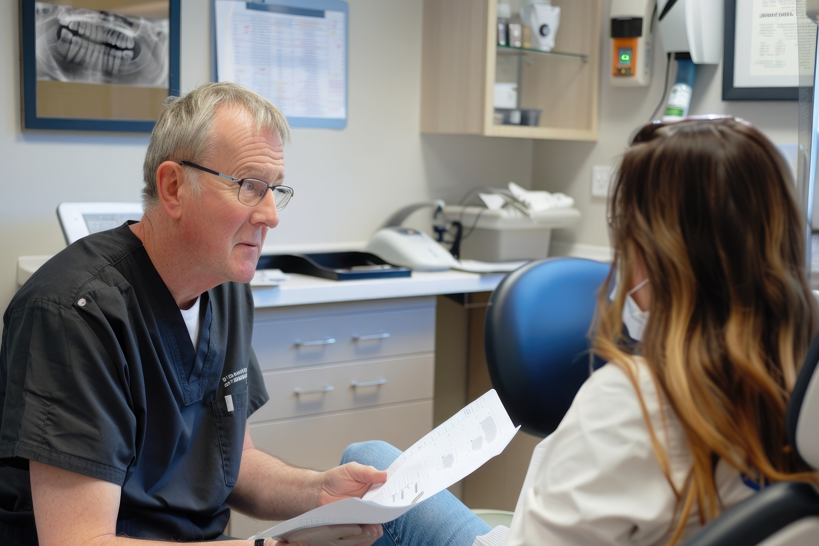
Informed consent processes in dental settings
  Simplify complex language for clear patient understanding.
  Conduct consent discussions in private, comfortable spaces.
  Address patient literacy levels and provide materials in multiple languages.
  Use visual aids to explain the study procedures and benefits.
  Allow time for patients to ask questions and consider their participation.
Notes:
Let’s now turn our attention to the processes that play an important role in recruitment and retention, specifically study enrollment and documentation. This includes key elements such as informed consent, HIPAA, confidentiality, and best practices that support patient-centered research.
In our consent process, we focus on clear communication by simplifying complex language and adapting materials for different literacy levels. These conversations are held in private, comfortable settings to encourage openness and trust.
We also use visual aids to help explain the study’s purpose, what participation involves, and the potential benefits. Most importantly, we give patients plenty of time to ask questions and carefully consider their decision to participate.
These thoughtful, respectful practices are essential to building trust, ensuring compliance, and supporting long-term engagement

Slide 17

Addressing patient concerns about experimental treatments
  Practitioners utilize their trusted relationships to engage patients.
  Communicate the difference between standard care and experimental procedures clearly.
  Reassure patients about the safety protocols in place.
  Address specific concerns like pain, recovery time, and long-term outcomes.
Notes:
To build trust and ease patient concerns, practitioners rely on their established relationships to engage patients in open, transparent conversations. This approach helps ensure patients feel fully informed and supported throughout their participation.
When discussing experimental treatments, practitioners clearly explain how the new intervention differs from standard care, helping patients understand what to expect.
We further reassure them by outlining our comprehensive safety protocols and addressing common concerns such as pain, recovery time, and long-term outcomes.

Slide 18
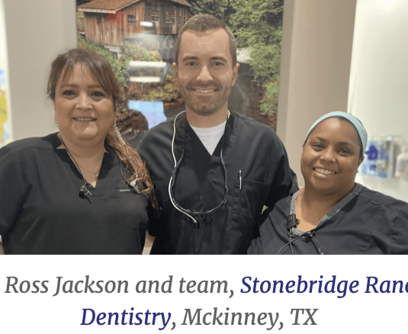
Addressing concerns in a clinical trial involving dental materials and drugs
Clear Communication of Study Design
Educational Outreach
Transparent Discussion of Benefits and Risks
Robust Safety Monitoring and External Oversight
Dedicated Patient Support
Ethical Oversight and Expert Involvement
Notes:
Some of our clinical studies involve dental materails and commonly prescribed drugs, such as antibiotics used in standard dental care. We ensure patients understand that all treatments follow strict safety protocols.
We use simple language and visuals to explain how the drug or dental material compares to standard care—highlighting potential benefits like improved durability or healing, along with possible risks.
Safety is monitored through routine follow-ups, oversight by trained dental professionals, and an independent board set up by NIDCR that can pause the study if concerns arise.
Patients also receive one-on-one support and clear information sheets. All studies are conducted under rigorous ethical standards, led by experienced dental experts, ensuring patient trust and safety remain our highest priorities.

Slide 19
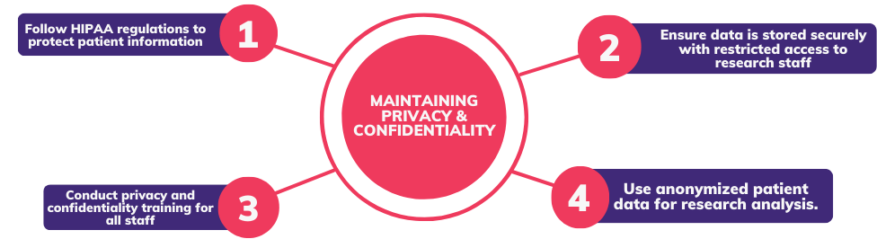
Maintaining privacy and confidentiality in dental studies
Notes:
In our studies, we prioritize data security and confidentiality by strictly adhering to HIPAA and the National Dental PBRN data management protocols, ensuring that we use secure data storage and limit access to maintain patient privacy.
At the same time, we are committed to continuous quality improvement, regularly monitoring recruitment metrics, gathering feedback from both patients and practitioners, and adapting our recruitment strategies based on the data and input we receive.

Slide 20
Best practices from a dental clinic-based study
Integrated Practice Approach
Tailored Recruitment Materials
Systematic Patient Identification
Patient-Centered Communication
Comprehensive Staff Training
Robust Informed Consent Processes
Attractive and Ethical Incentive Programs
Effective Follow-Up Strategies
Data Security and Confidentiality
Continuous Quality Improvement
Notes:
As noted earlier, we apply these best practices across our studies, so I’ll just highlight a few key points.
We align research with routine dental visits to ease participation, using targeted recruitment materials and real-time patient identification. Communication is patient-centered, supported by trained staff and clear consent procedures.
We offer appropriate incentives, schedule follow-ups alongside dental care, and use reminders to boost retention. All data is managed securely, and we continuously refine our approach based on feedback and performance.

Slide 21
Lessons learned from a difficult-to-recruit study population
Pre-Screening and Advance Communication
Efficient Enrollment Tracking
Visual Engagement Tools
Collaborative Training Initiatives
Expanding Recruitment Networks
Ongoing Communication and Support
Notes:
Let me share a few key lessons from working with a hard-to-recruit population. We found that pre-screening patients and sending consent forms ahead of time helped speed up enrollment.
Tracking enrollment with simple logs made it easier to spot and fix any issues. To boost awareness, we used eye-catching flyers in clinics and trained both staff and dentists together to make sure everyone was on the same page.
When a practice didn’t have enough eligible patients, we expanded recruitment by bringing in new practices and targeting specific zip codes where more potential pateints might live.
Most importantly, regular communication through newsletters and emails and strong coordinator-practitioner relationships kept everything running smoothly

Slide 22
Overcoming Recruitment Issues
Quick polls
Utilizing existing practitioner relationships for trust-building
Tailoring recruitment materials, advertising in Network and Association newsletters, postal and electronic mailing
Conducting informational outreach events such as hosting informational webinars, seminars, symposiums, and exhibit booths at conferences.
Notes:
We recognize that recruitment challenges are common, but instead of reinventing the wheel, we continue to build on strategies that have worked, while refining them for even better results.
For example, we’ll keep using short surveys through news letters to gauge interest and identify potential participants early on. Trust remains key, so we continue to rely on strong practitioner relationships to boost credibility and encourage participation.
We’re also enhancing how we tailor and distribute recruitment materials, placing them in professional networks, association newsletters, and using both postal and electronic mail to broaden our reach.
Finally, outreach events like webinars, seminars, and conference booths remain a cornerstone of our efforts to inform and engage new participants.

Slide 23
Overcoming Retention Issues
Identify and address barriers like time constraints, competing priorities, or patient hesitancy.
Use flexible scheduling and remote follow-ups to accommodate busy patients.
Personalize retention strategies by understanding patient motivations (health, financial, altruistic).
Utilize favorable communication tools (bi-weekly phone calls, bi-weekly emails, text messaging, virtual meetings via zoom) to connect with practitioners personally
Notes:
Just like recruitment, retention is key to a study’s success and we’re committed to improving it by continuing strategies that work and refining them as we go.
We start by recognizing common barriers like time constraints, competing demands, or uncertainty about participation. To address these, we offer flexible scheduling, remote follow-up options, and personalized engagement based on what motivates each participant whether it's better health, incentives, or simply the desire to contribute.
Regular, clear communication also plays a big role. We stay in touch through phone calls, texts, emails, or virtual check-ins to maintain strong connections and keep participants engaged.
By strengthening what works and tailoring our approach, we can build lasting participation and set our studies up for long-term success.

Slide 24
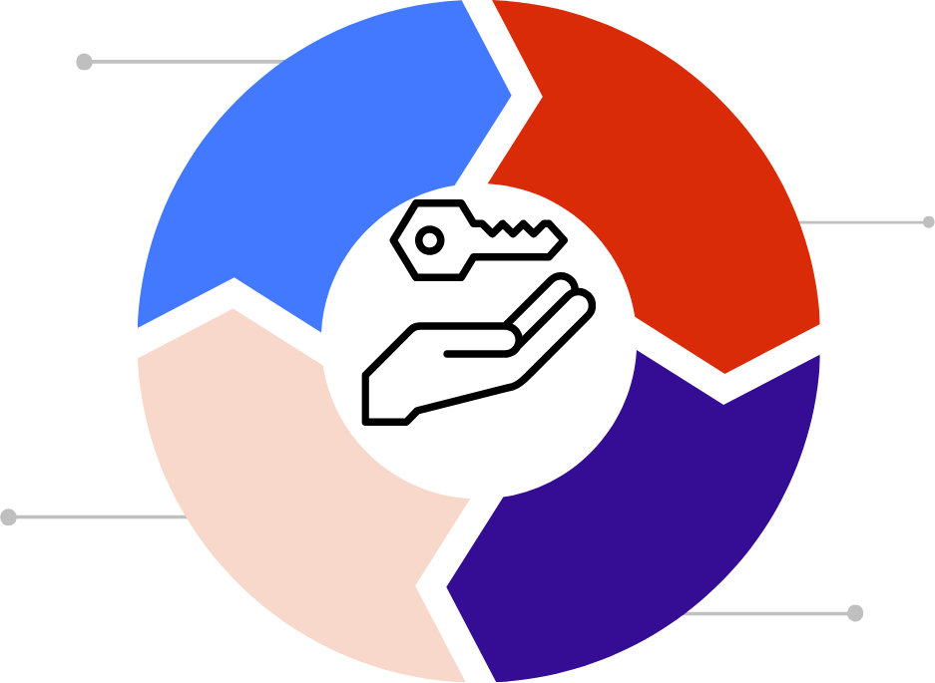
Key Takeaways
Patient-centered recruitment and consent processes are key.
Collaboration with dental practitioners enhances recruitment and retention.
Address patient concerns proactively for experimental treatments.
Long-term follow-up requires constant engagement and planning.
Notes:
As we conclude, let’s highlight the key takeaways.
First, patient-centered recruitment and consent processes are essential to building trust and ensuring participation.
Addressing patient concerns proactively, especially for experimental treatments, can significantly improve retention.
Collaboration with dental practitioners strengthens recruitment efforts and fosters sustained engagement.
Lastly, successful long-term follow-up demands ongoing planning and active communication with participants. By integrating these strategies, we can enhance recruitment, retention, and overall study outcomes.

Slide 25
References Cited
Mungia R, Funkhouser E, Cochran DL, et al. Recruitment strategies and retention rates for five National Dental PBRN studies. J Clin Transl Sci. 2024;8(1):e56. Published 2024 Mar 22. doi:10.1017/cts.2024.499
Mungia R, Funkhouser E, Makhija SK, et al. Practitioner Engagement in Activities of the National Dental Practice-Based Research Network (PBRN): 7-Year Results. J Am Board Fam Med. 2020;33(5):687-697. doi:10.3122/jabfm.2020.05.190339
Mungia R, Funkhouser E, Buchberg Trejo MK, et al. Practitioner Participation in National Dental Practice-based Research Network (PBRN) Studies: 12-Year Results. J Am Board Fam Med. 2018;31(6):844-856. doi:10.3122/jabfm.2018.06.180019
Funkhouser E, Mungia R, Laws R, et al. Participation Rates in 11 National Dental Practice-Based Research Network Surveys 2014-2022. Eval Health Prof. Published online June 6, 2024. doi:10.1177/01632787241259186

Slide 26
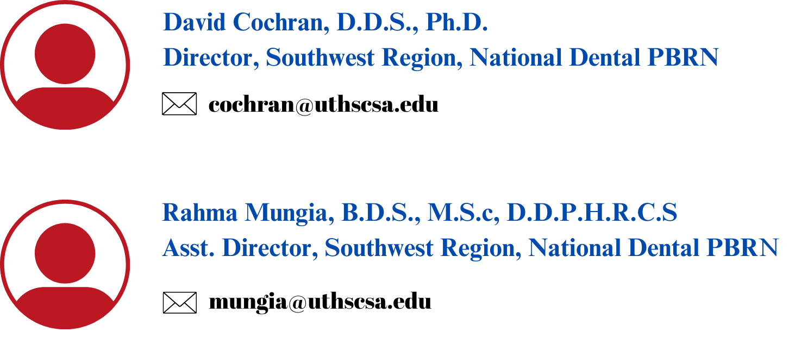
Presenter Contact Information

Slide 27
Contact the National Dental PBRN
(205) 996-7634
UAB Medical Towers: 1717 11th Ave S, Birmingham, AL 35205
nationaldpbrn@uab.edu
nationaldentalpbrn.org

Slide 28
Thank you!

