Slide 1
Communication & Dissemination Updates
AUGUST 2024
National Dental PBRN
Hello,
San Antonio!
Joana Cunha-Cruz, DDS, PhD & Brittni Ball, MS
8/27

Slide 2
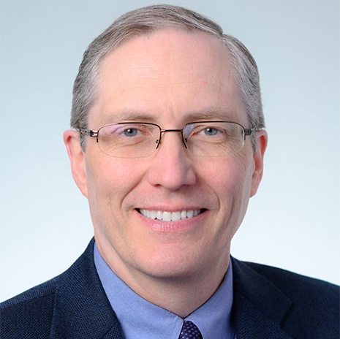
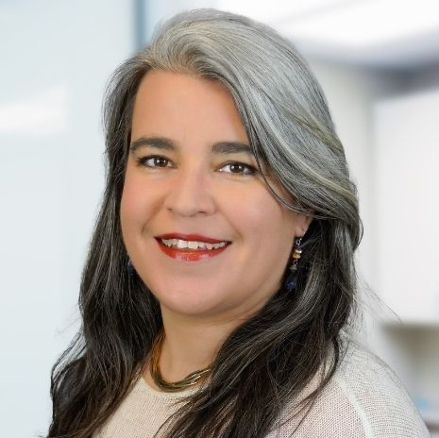
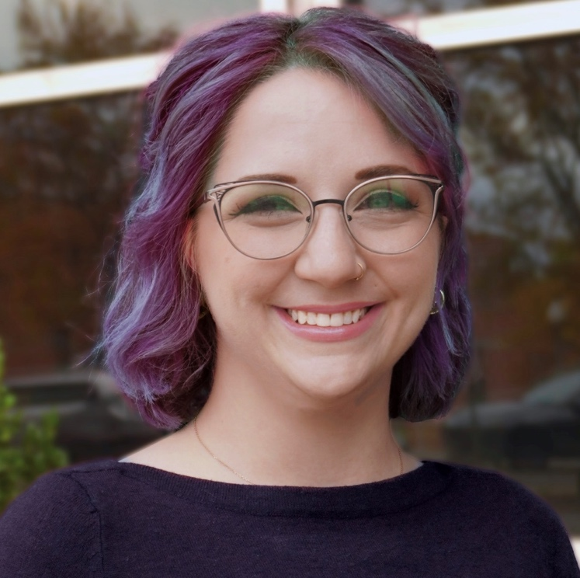
C&D Team
Gregg H. Gilbert, DDS,
MBA,
FAAHD,
FACD,
FICD
Joana Cunha-Cruz, DDS,
PhD
Brittni Ball,
MS
National Network Director
National Director of C&D
National Program Coordinator

Slide 3
What we do
Communication & Dissemination focuses on increasing the visibility of the PBRN in the dental community through:
Webinars and Virtual Meetings
In-person presentations
Publications and press releases
Quick Polls
Social media
Website resources and blog posts
Newsletters and email updates

Slide 4
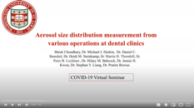
Webinars

Slide 5
Non-Peer-Reviewed Publications & Presentations
June
& later
so far

Slide 6
Peer-Reviewed Publications
183
authors
10 countries
49 universities and organizations
June
& later
Collaborations
Accepted for Publication: 1
In Development: 3
Under Review at a Journal: 8
so far

Slide 7
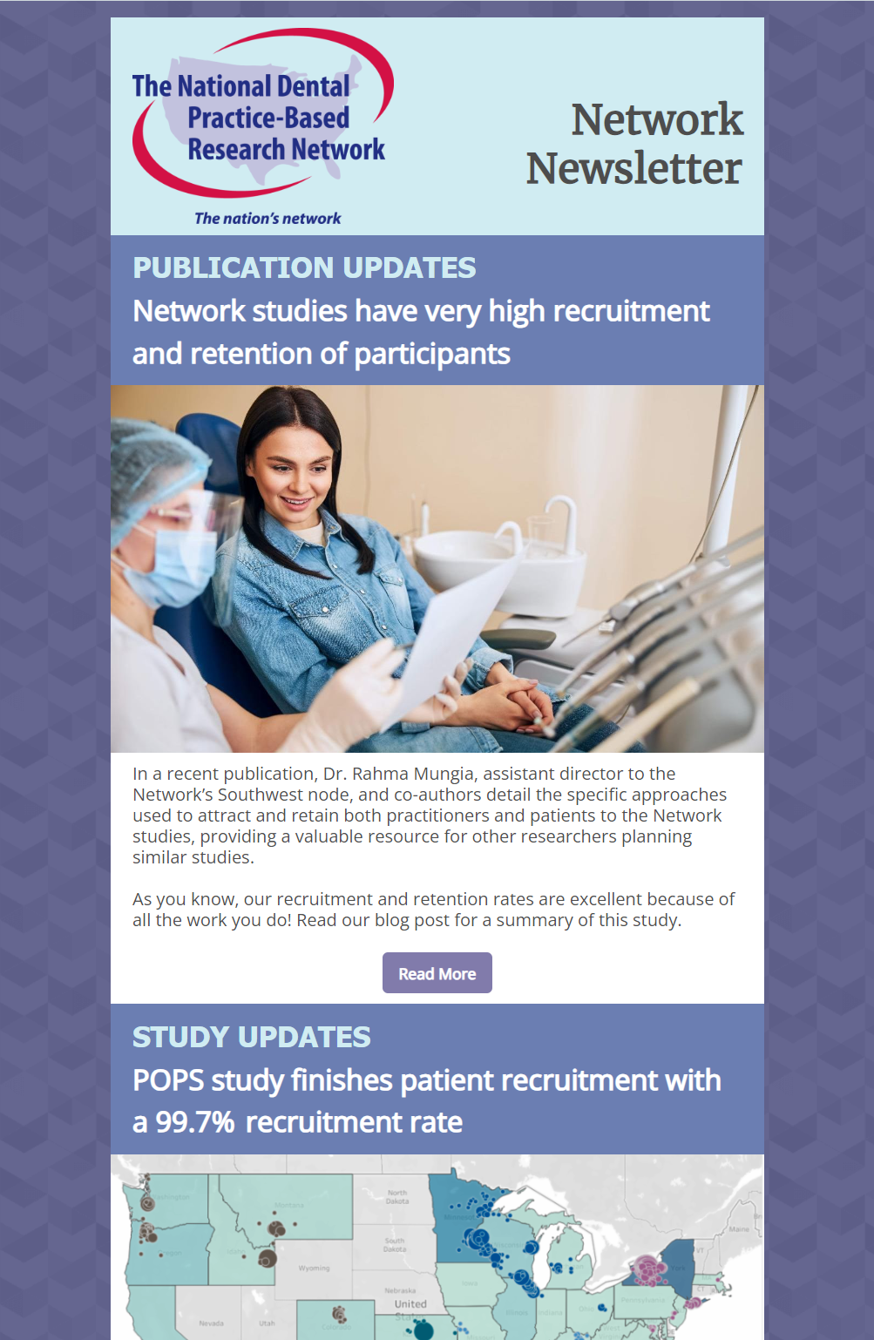
Newsletters
75K sends
32K opens
3K clicks
Open rate 11% higher than industry average
Click rate 2% higher than industry average
Click rate up 5% in last year
28 total in cycle 3
*in past 12 months

Slide 8
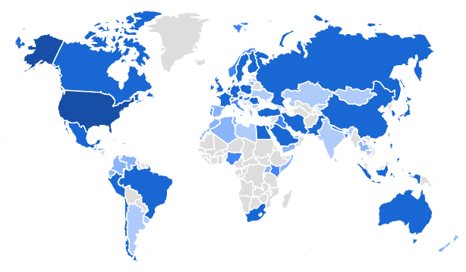
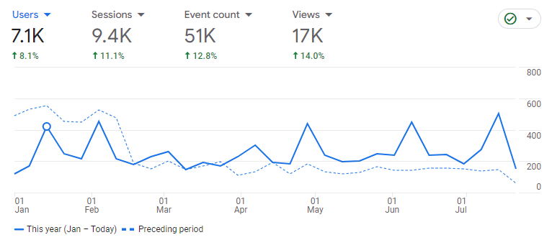
Website & blog posts
60 total blog posts in Cycle 3
Website redesign in 2022

Slide 9
Quick Polls
22 total in Cycle 3

Slide 10
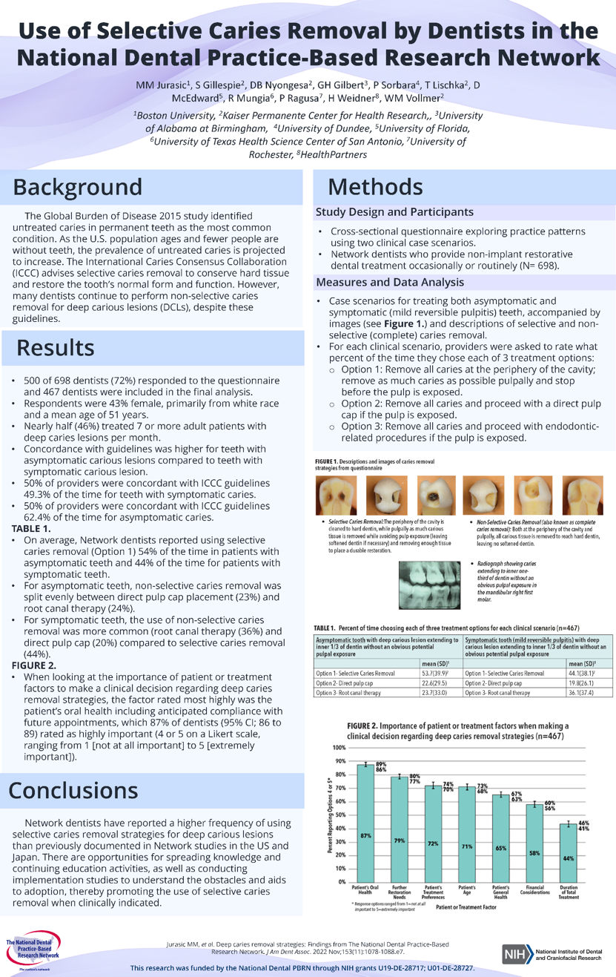
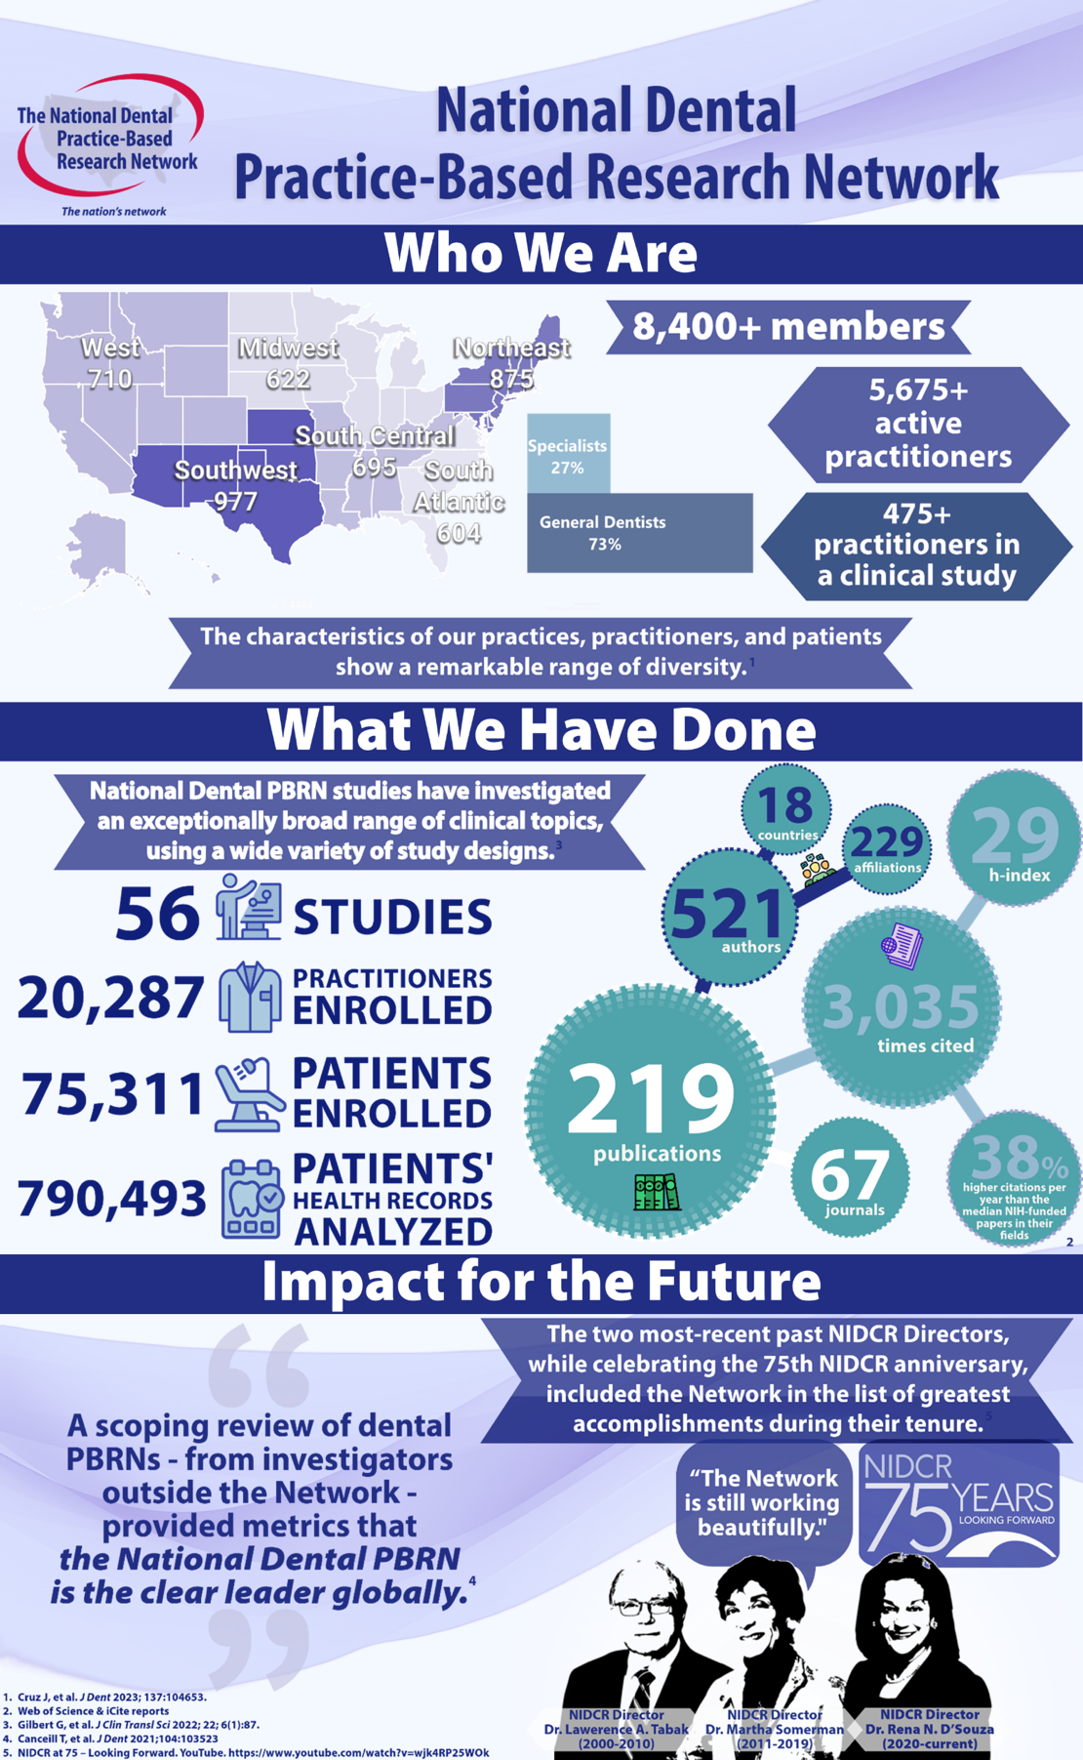
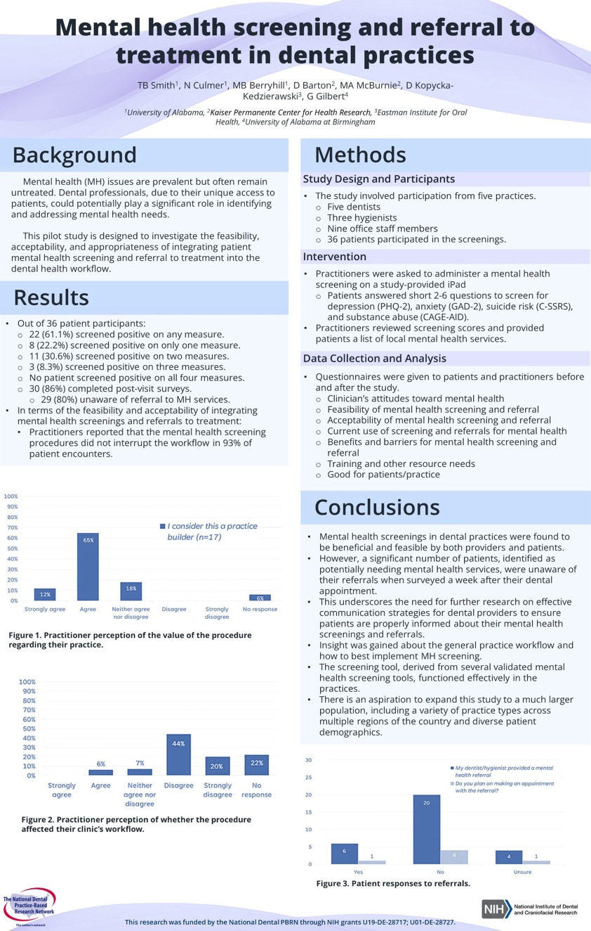
Posters & Flyers

Slide 11
Thank you!
AUGUST 2024
National Dental PBRN
Goodbye,
San Antonio!
8/27

Slide 13
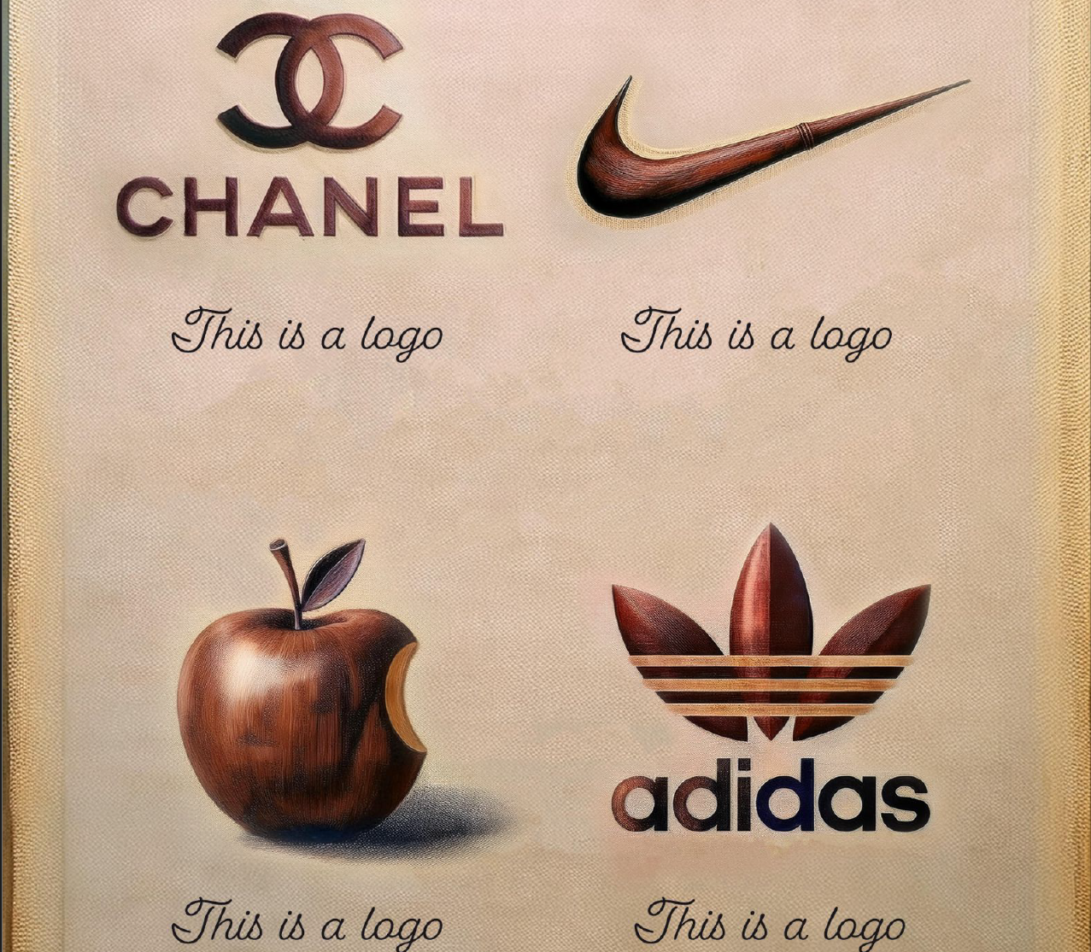

Slide 17
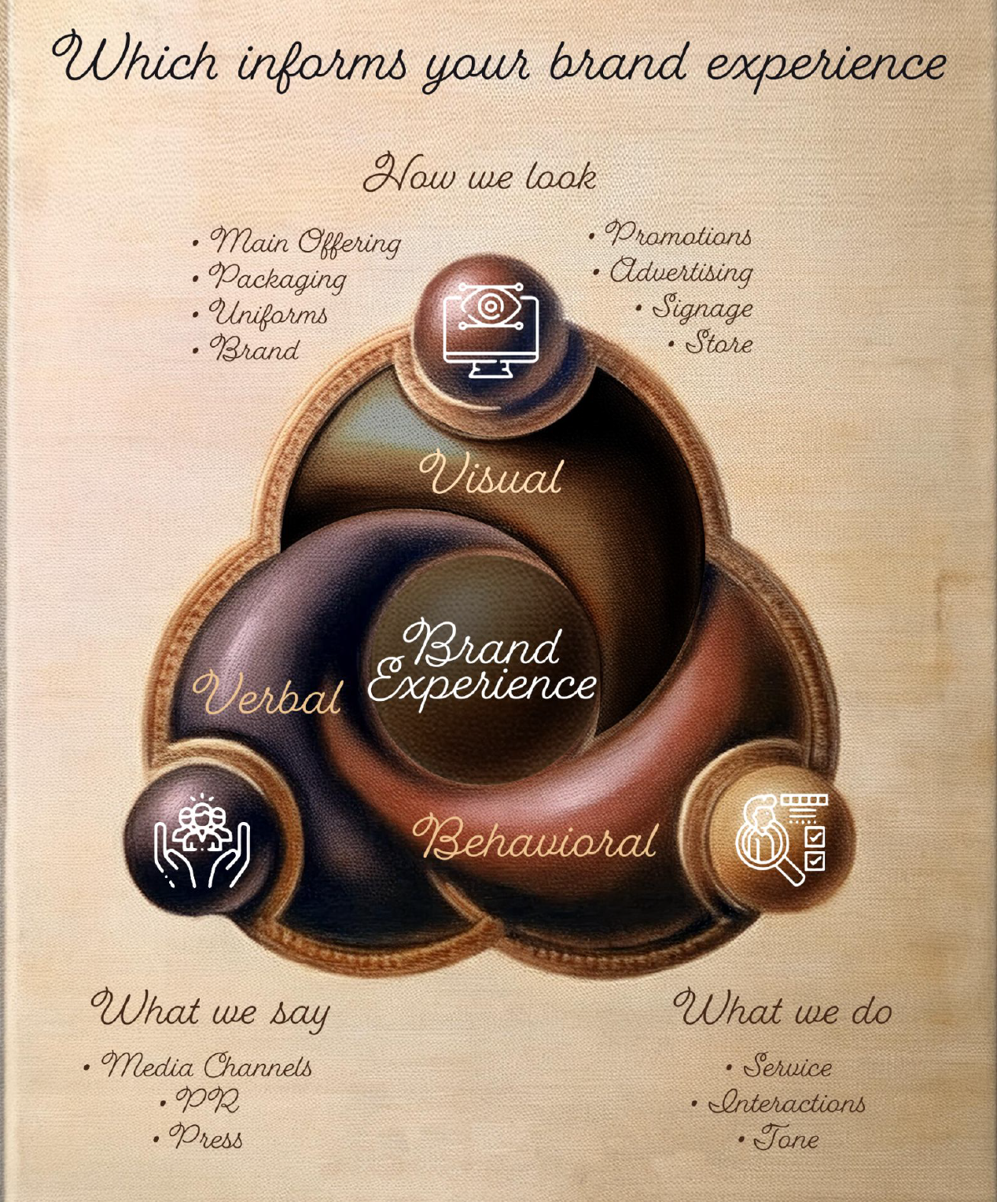

Slide 20
2011
2012

Slide 21
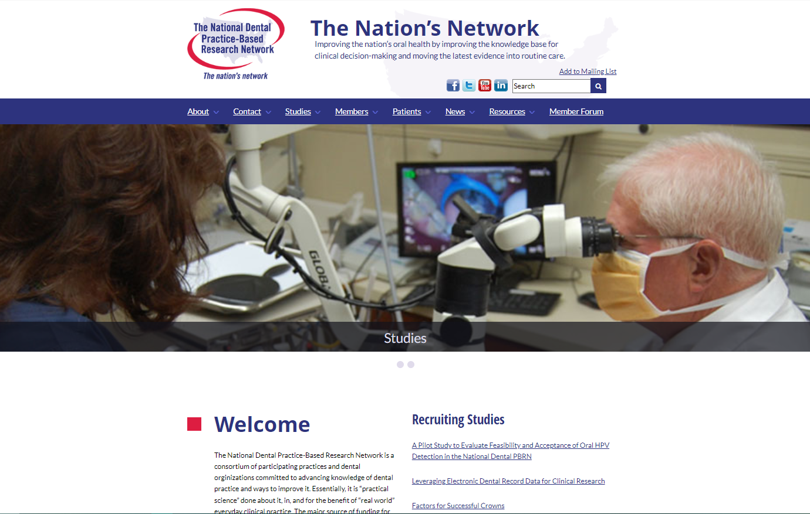
2011
2012
2016

Slide 22
2012
2016
2020

Slide 23
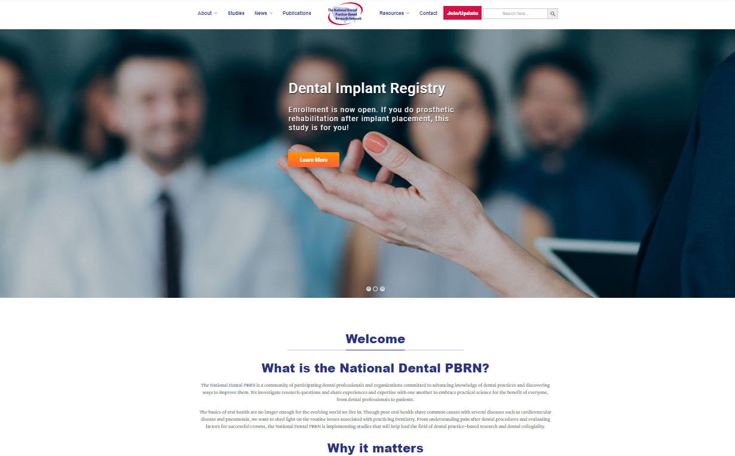
2016
2020
2022

Slide 24
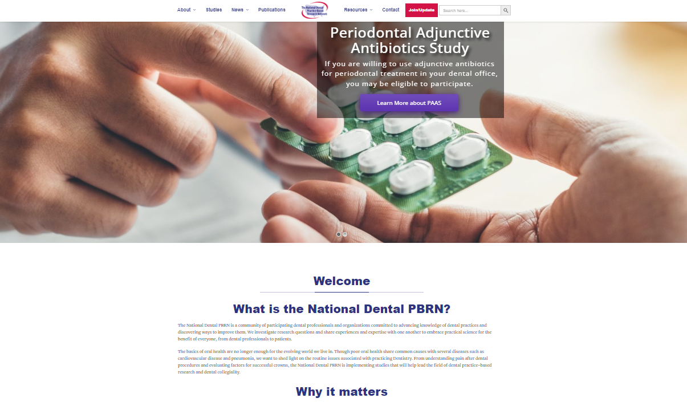
2020
2022
2024

Slide 25
2022
2024

Slide 26
Branding Opinion Survey
https://nationaldentalpbrn.org/2024F2F

