Slide 1
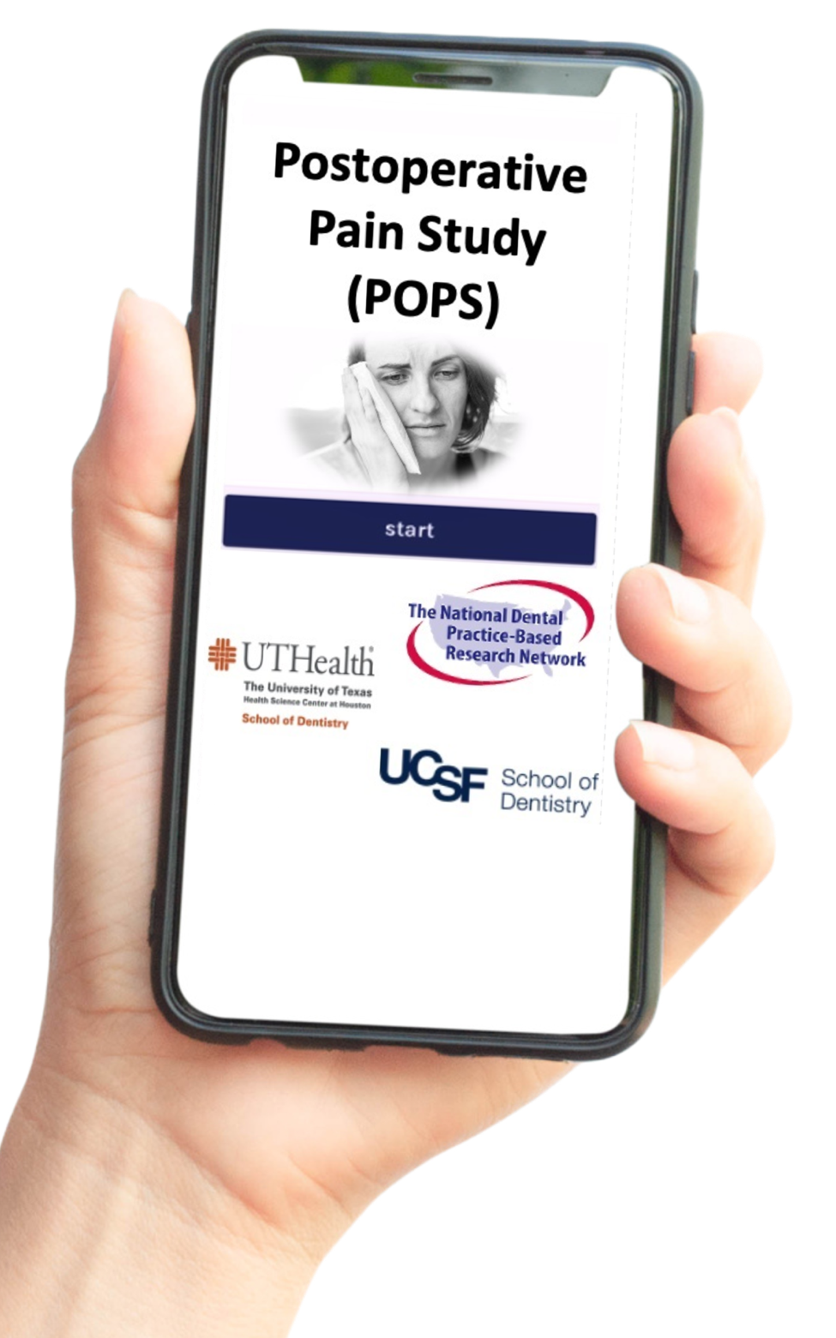
POSTOPERATIVE PAIN STUDY (POPS)

Slide 2
Study Goals
Assess post-operative pain experience as reported by patients
Assess post-operative pain management strategies as reported by patients and providers
Evaluate acceptance of the mHealth platform
Should lead to insight on (1) post operative pain & pain management and (2) willingness to use mHealth

Slide 3
Study design
Observational design: Tracking patients' pain experiences and pain management strategies for 21 days after their procedures.
Data collection: Patients reported pain levels, other symptoms, and satisfaction with pain management through FollowApp.Care via secure text messages.
Sample size: 3,147 patients from 150 practices nationwide (up to 30 patients/practice)
Outcomes: (1) Identifying procedure-specific pain patterns. (2) Evaluating and refining pain management strategies based on real-time data. (3) Assessing the usability and feasibility of FollowApp.Care in a dental setting.

Slide 4
Interim Analysis: Associations
Pre-op dental pain
Medication taken
Time since procedure
Post-operative dental pain
Dental procedure
Complications: Bleeding and swelling
Patient factors
Patient’s ethnicity
Patient’s age
Patient’s gender
Patient’s SES: Income, Insurance, neighborhood etc.
Non-medicine pain relief methods
Patient’s race

Slide 5
Study Timeline
NOV 2021
MAY 2022
FEB 2024
MAY 2024
JULY 2025
AUG 2021
STUDY SETUP
RAMP-UP
FULL STUDY
DATA ANALYSIS

Slide 6
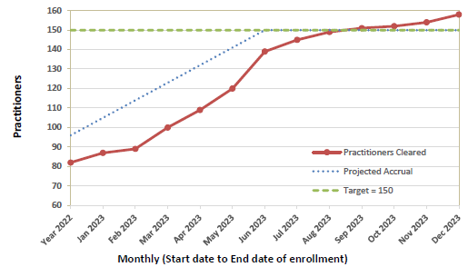
Practitioner Recruitment Progress
>100% practitioners recruited As of February 29, 2024
158
57% Male
42% Female
76.6% General Practitioners
21.5% Specialists

Slide 7
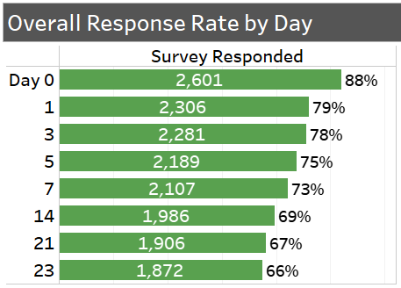
Patient Recruitment Progress
95% patients recruited as of February 29, 2024
2998

Slide 8
Demographic distribution of patients
Race
59% Caucasian
12% African American
5% Asian
2% Multiple
56% Male
44% Female
Ethnicity
11% Hispanic
Total participants: 2971

Slide 9
Distribution of Dental Procedures
82% of all procedures
Non-surgical Endo, Extractions, Surgical Implants
Total participants: 2971

Slide 10
Postoperative medications and complications
42% also used non-medicine pain relief methods

Slide 11
Unadjusted Average Pain Intensity (Scale: 0-10)
Similar trajectories – decrease in pain levels
Notes:
Most importantly, these are unadjusted pain levels – next we add medications and pre-operative pain levels to the model to study variations in pain levels by procedures.

Slide 12
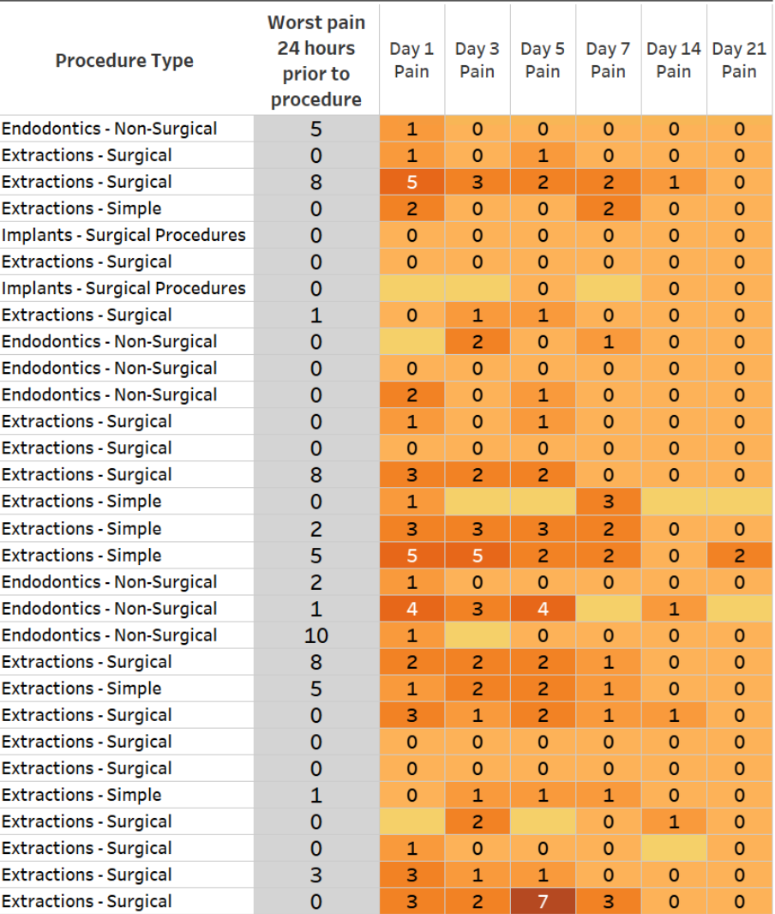
Patient Pain Report Card
Each practitioner received a personalized report card with the pain ratings of their study participants

Slide 13
Discussion
How does the example report of post-operative pain from one practice compare to that in your practice?
Do you currently utilize any mHealth solutions to track patients' post-operative pain? If so, what are your experiences with them?
Based on the preliminary data from the POPS study, what insights do you find most surprising or informative?
How do you think utilizing a platform like FollowApp.Care could inform your approach to prescribing pain medication after dental procedures?
What potential challenges do you foresee in implementing this technology in your clinic?

Slide 14
The National Dental PBRN and the POPS Study are supported by
NIH grants U19-DE-28717 and UH3-DE-029158
during 2019-2025
Please visit our website at NationalDentalPBRN.org

